Slide 1
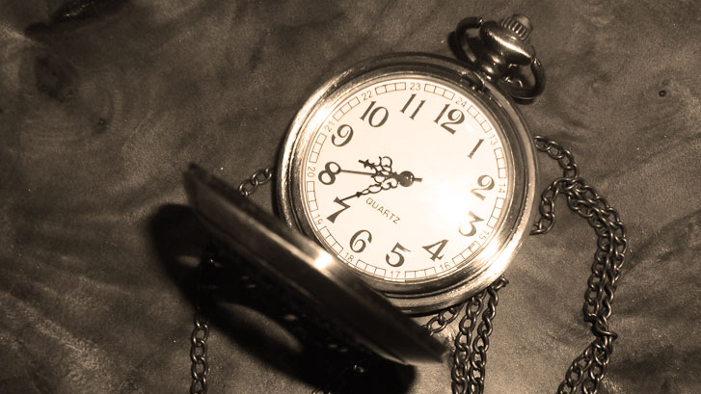
Making the Most of Your 24/7: Using Time to Your Advantage
Misericordia University
August 19, 202
Dave Kelly
America’s Leadership Trainer^{sm}
This Photo by Unknown Author is licensed under CC BY-SA-NC

Slide 2
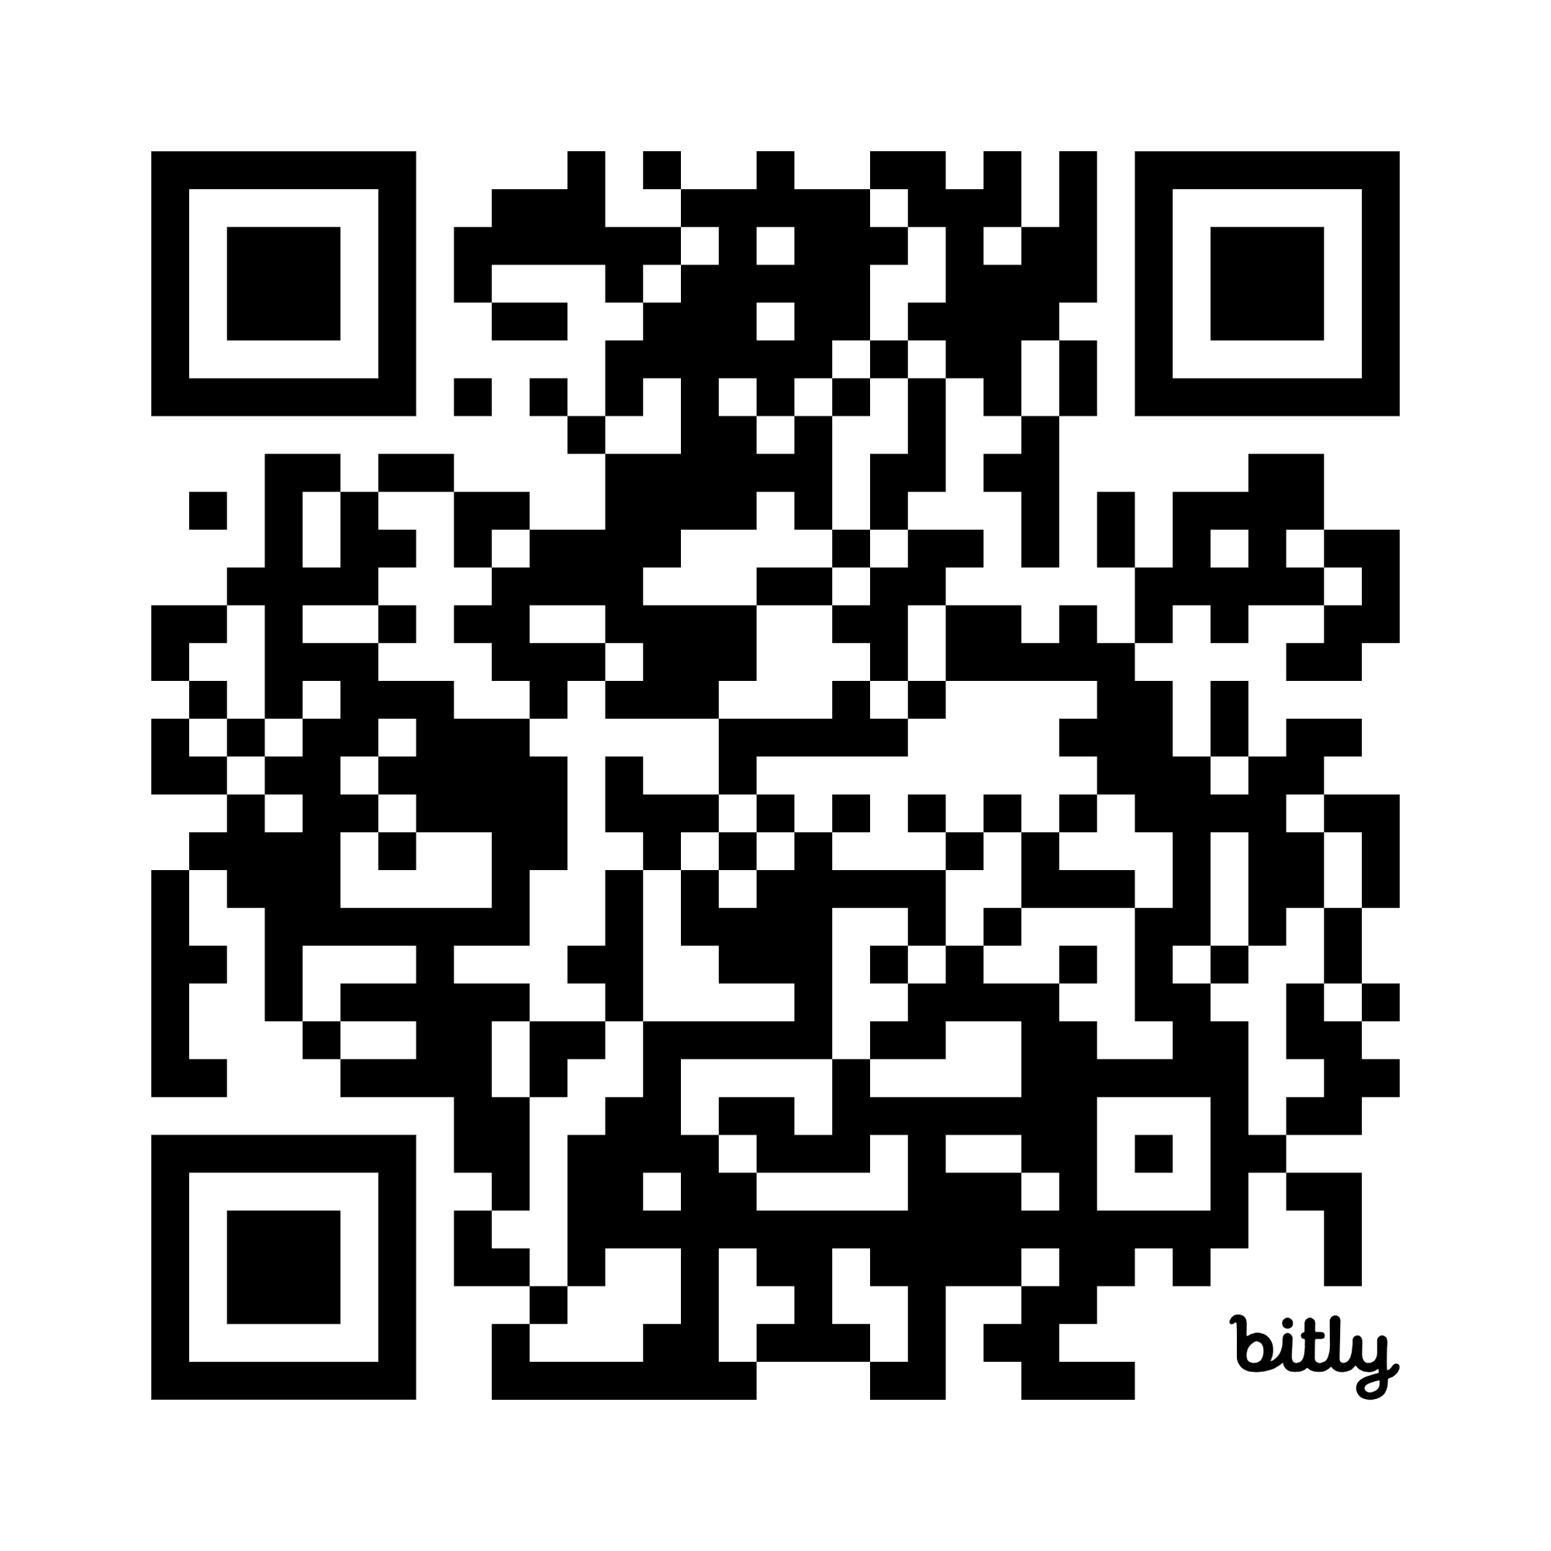
Handout for this program
https://bit.ly/41636Ia

Slide 3

24 Hours in Every Day
@DaveGonzoKelly

Slide 4
Each hour =
60 minutes
@DaveGonzoKelly

Slide 5
Each minute
=
60 seconds
@DaveGonzoKelly

Slide 6
Each day is… one thousand four hundred forty minutes
OR eighty-six thousand four hundred seconds
@DaveGonzoKelly

Slide 7

What do YOU do with your time?
@DaveGonzoKelly

Slide 8
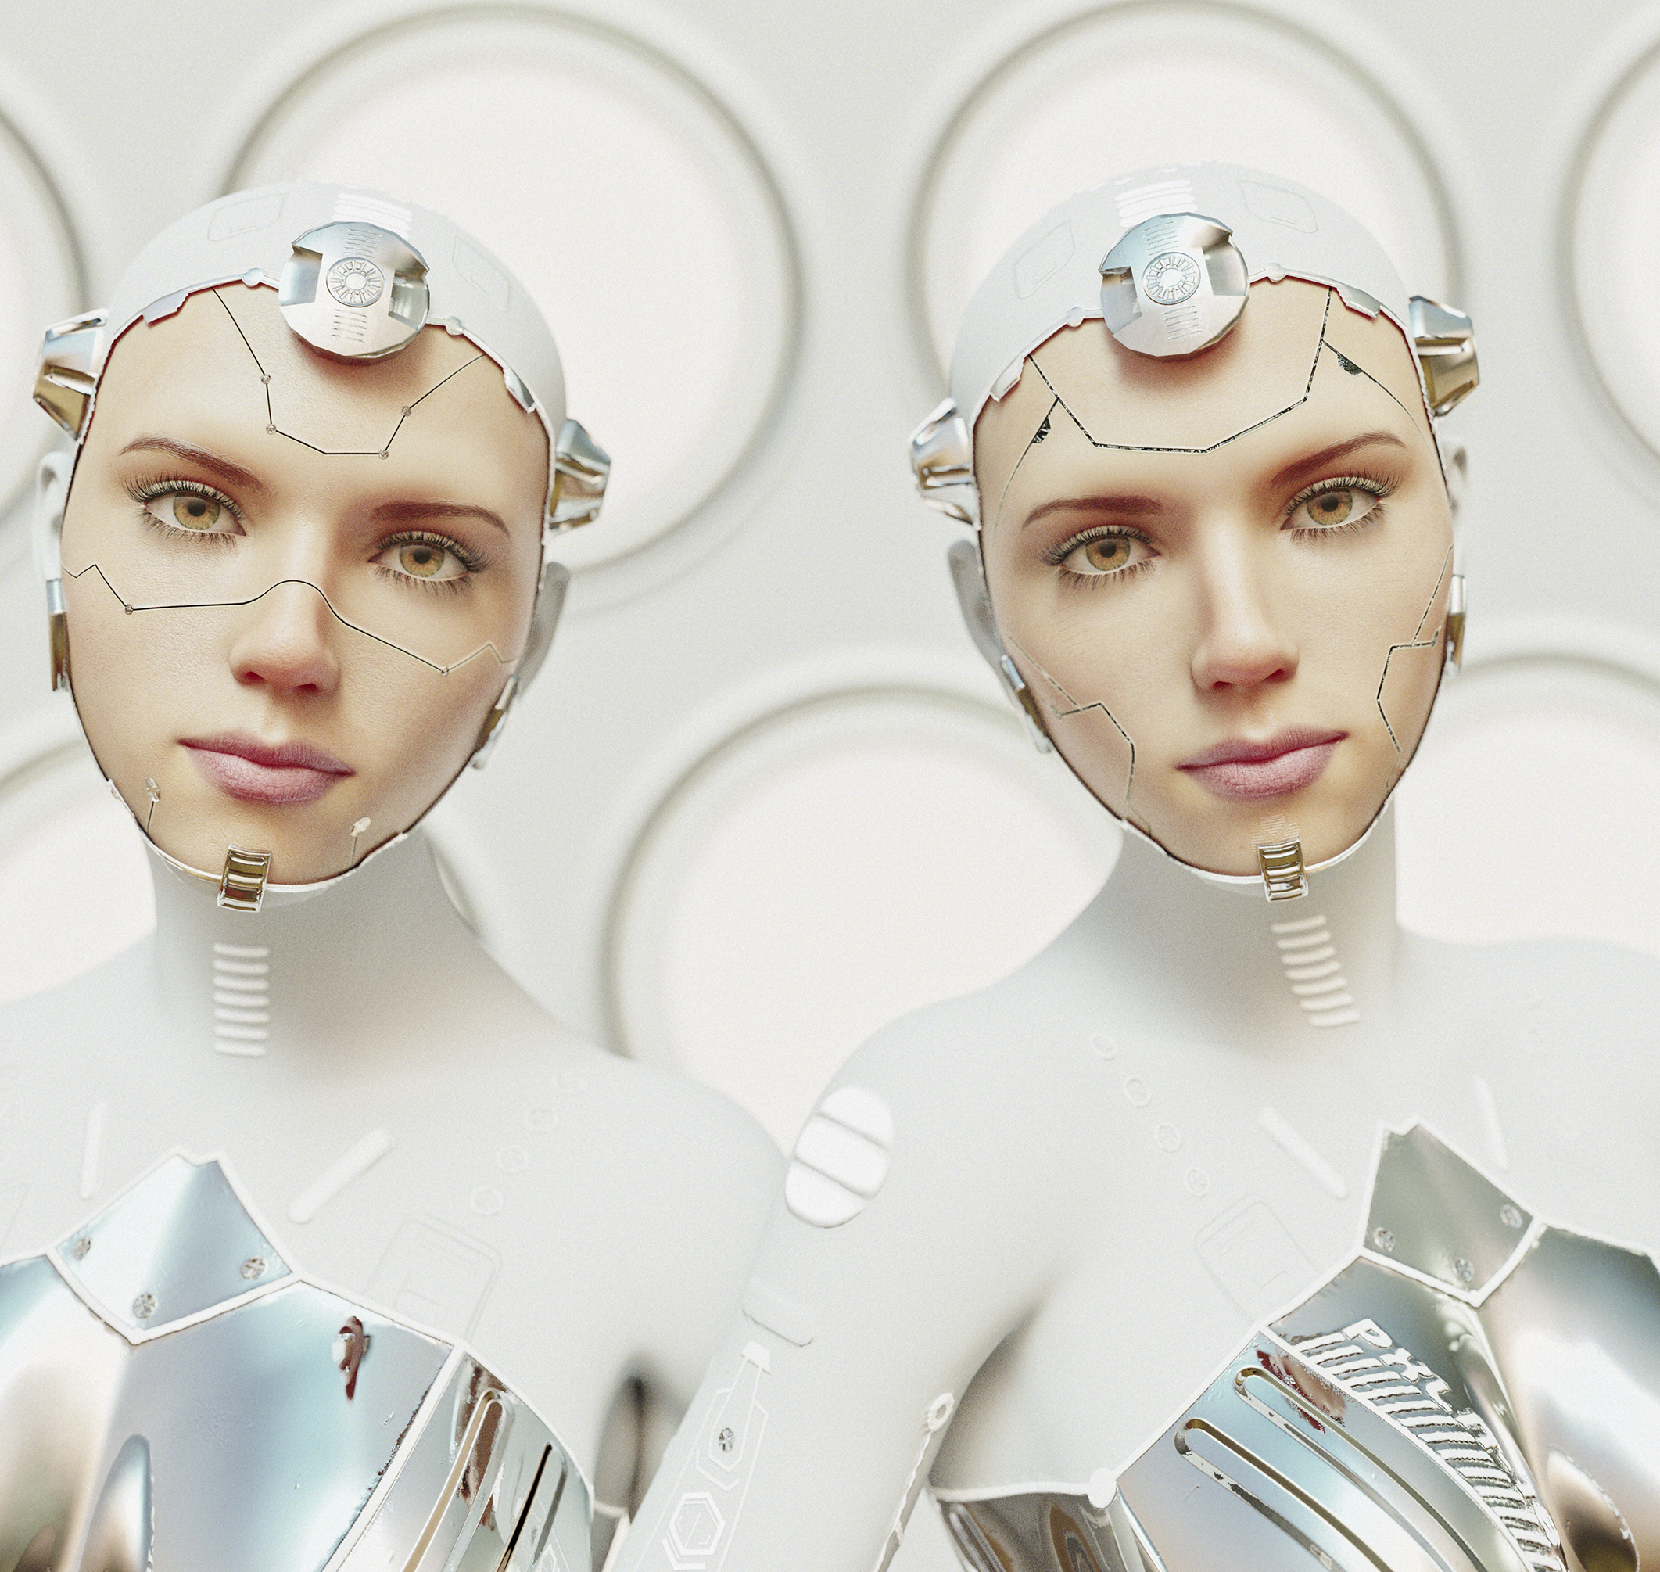
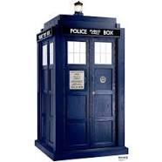
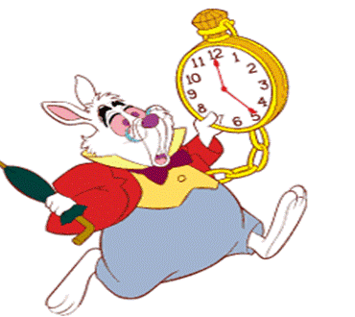
Use Your Time Effectively!
@DaveGonzoKelly

Slide 9
5 Seconds
@DaveGonzoKelly

Slide 10
Your
Business Card Listings
@DaveGonzoKelly

Slide 11


Slide 12

Making the Most of Your 24/7
  2. Maximize your time!
This Photo by Unknown Author is licensed under CC BY-NC
@DaveGonzoKelly

Slide 13
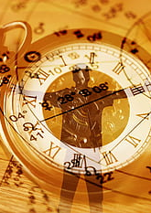
Making the Most of Your 24/7
  Work on that which is most important.
@DaveGonzoKelly

Slide 14
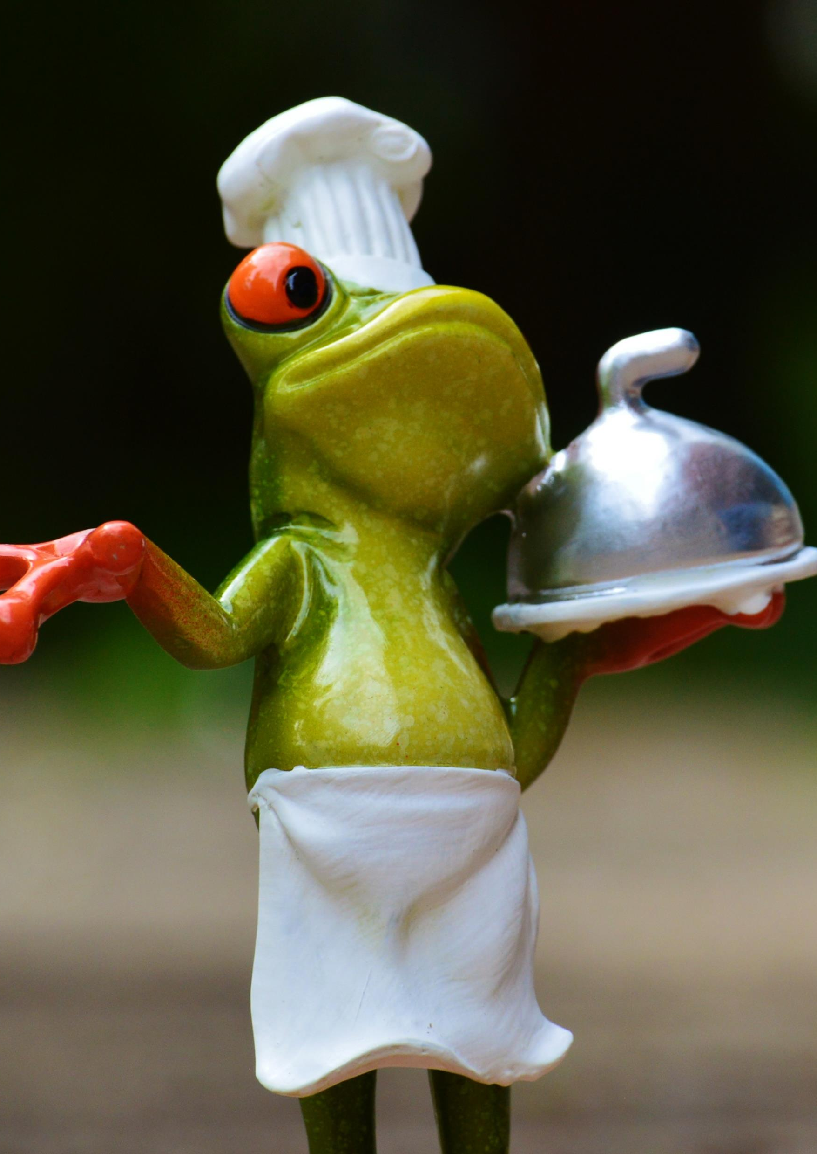
Making the Most of Your 24/7
  Work on that which is most important.
  Do the dreaded thing first.
@DaveGonzoKelly

Slide 15
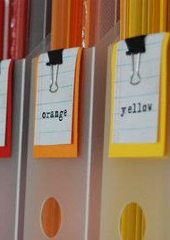
Making the Most of Your 24/7
  Work on that which is most important.
  Do the dreaded thing first.
Work space: organize to prioritize.
This Photo by Unknown Author is licensed under CC BY-NC-ND
@DaveGonzoKelly

Slide 16
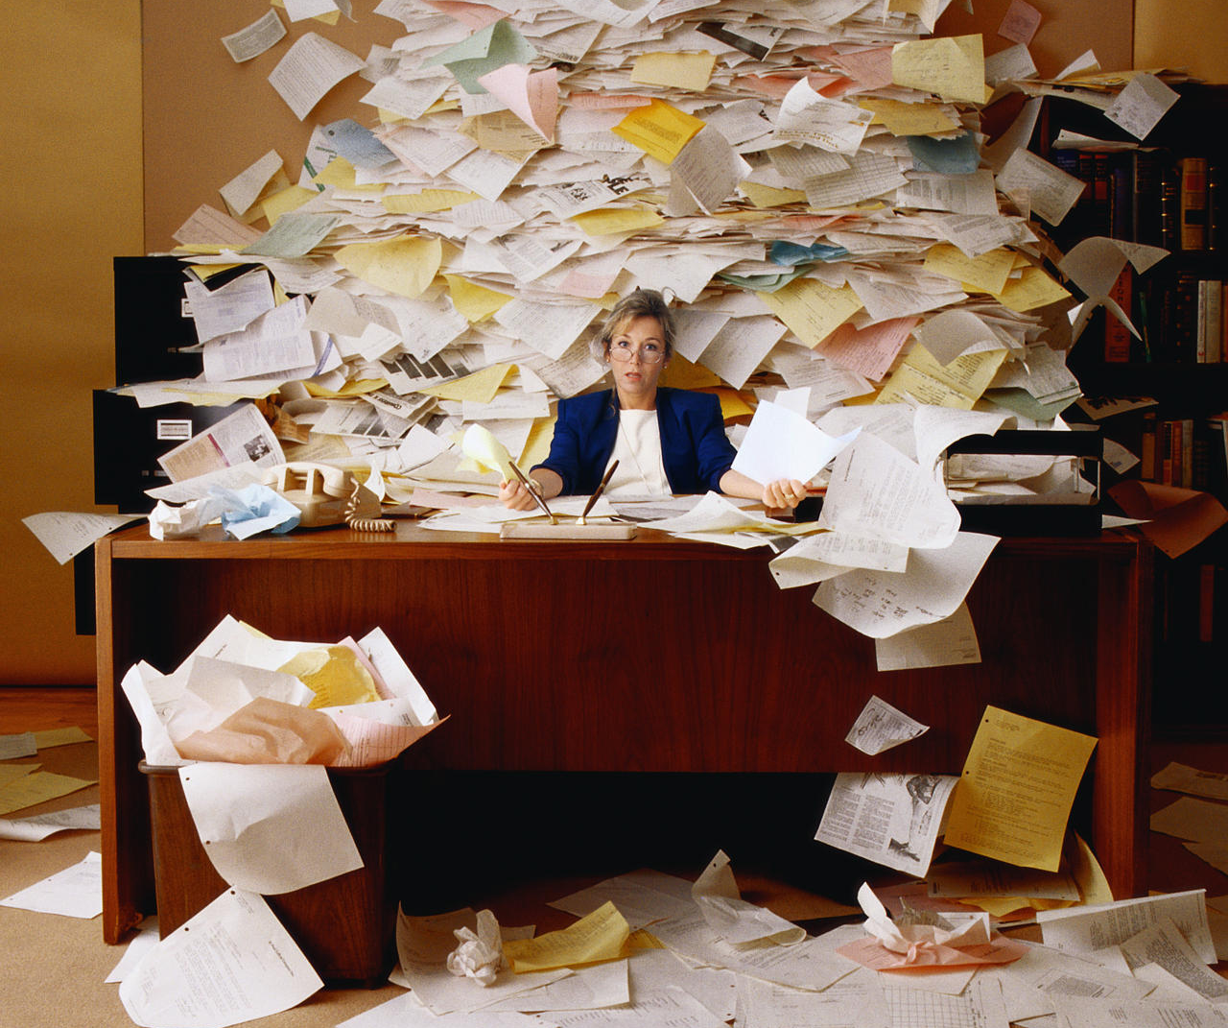
“You cannot create success in a mess.”
--Me.
@DaveGonzoKelly

Slide 17

Making the Most of Your 24/7
Enemy of priorities: distractions.
What distractions do you have in your life? (Use the space on the handout to write some of yours down and those others share)
This Photo by Unknown Author is licensed under CC BY-NC-ND
@DaveGonzoKelly

Slide 18

Making the Most of Your 24/7
Enemy of priorities: distractions.
Determine your priorities to
conquer your distractions.
This Photo by Unknown Author is licensed under CC BY-SA-NC
@DaveGonzoKelly

Slide 19
Grading Method
 | Task | Grade | Completed
1.
2.
3.
4.
5.
@DaveGonzoKelly

Slide 20
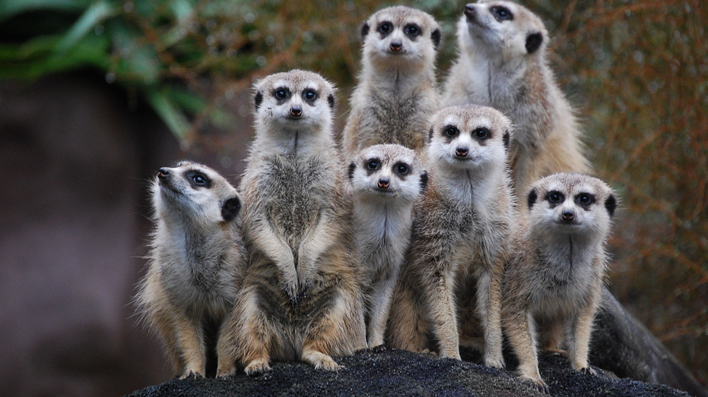
Small Groups

Slide 21
Organize or
Agonize
High Importance/ High Urgency Do first | High Importance/ Low Urgency Set deadlines for completion; work into daily routine
Low Importance/ High Urgency Find ways to get done quickly | Low Importance/ Low Urgency Usually busy or repetitious work
@DaveGonzoKelly

Slide 22
Small Groups

Slide 23
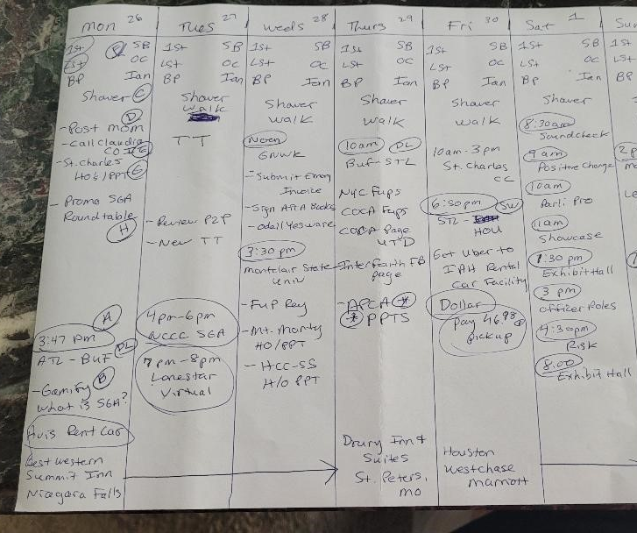
Dave’s Grid
@DaveGonzoKelly

Slide 24
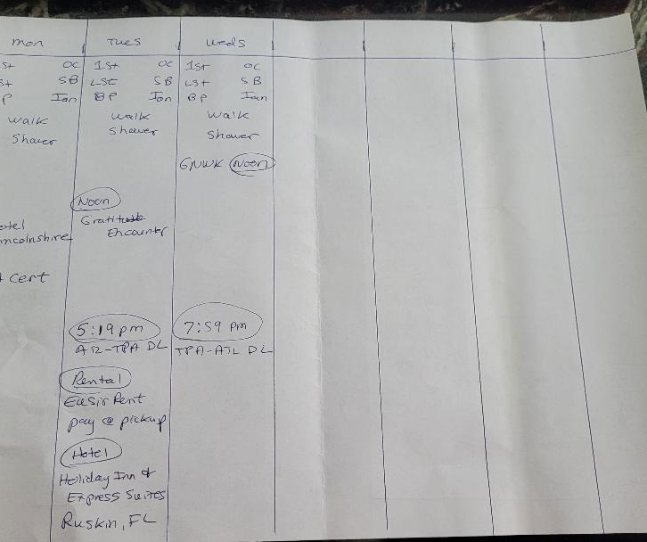
Dave’s Grid
The Other Side
@DaveGonzoKelly

Slide 25

Making the Most of Your 24/7
You are in control of your technology.
This Photo by Unknown Author is licensed under CC BY-NC-ND
@DaveGonzoKelly

Slide 26
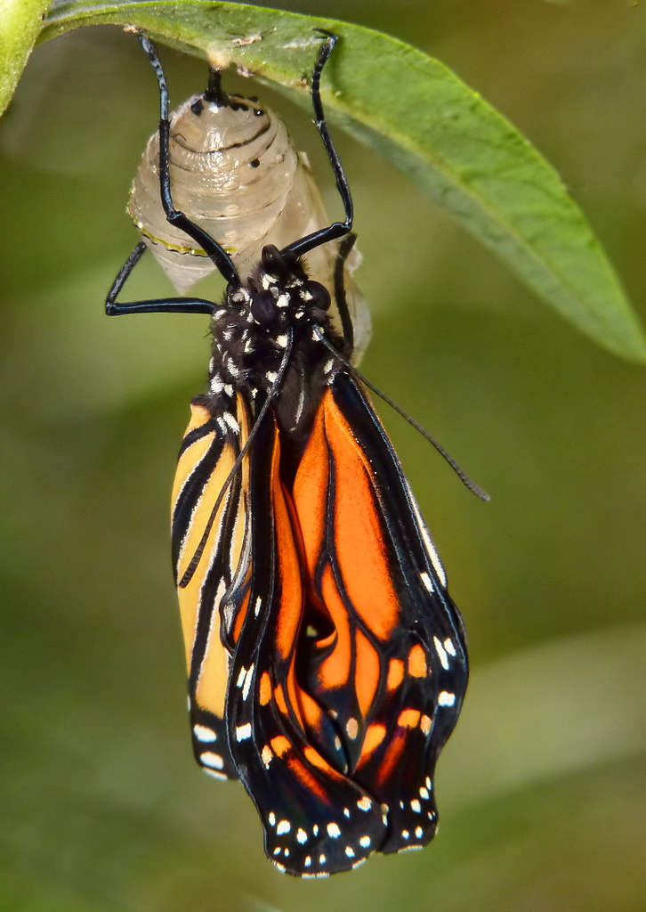
Making the Most of Your 24/7
Work things through to a completion.
This Photo by Unknown Author is licensed under CC BY
@DaveGonzoKelly

Slide 27
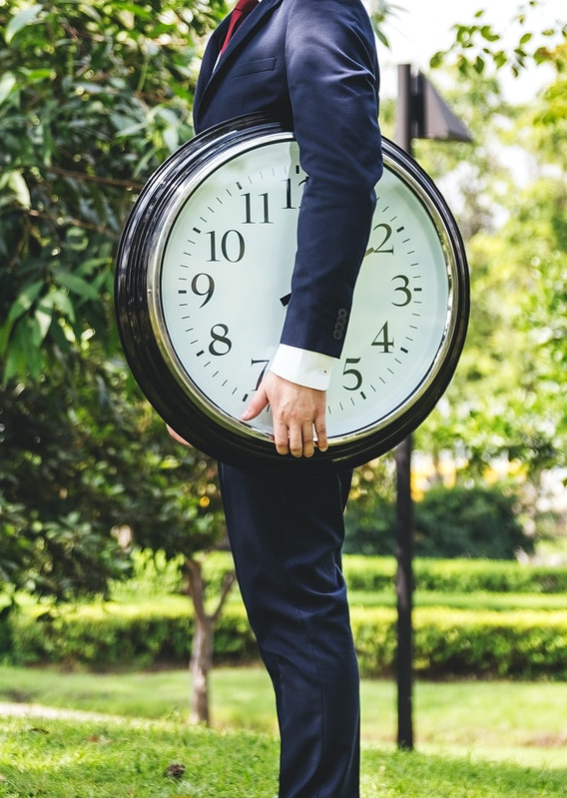
Making the Most of Your 24/7
Schedule your time, for, work, family, and play.
@DaveGonzoKelly

Slide 28

Making the Most of Your 24/7
Schedule your time, for, work, family, and play. Before you start to study, engage in programs, or play, take a piece of paper and write down everything that is on your mind that is outside of what you are about to do. Put it some place safe; this is your memory list or thought page.
This Photo by Unknown Author is licensed under CC BY-NC
@DaveGonzoKelly

Slide 29
Thought Page
Thought Page
Many people come to a session like this with a lot of things on their minds. More than likely, you will not be able to solve those problems while you are here and thinking about them during the program could lessen your involvement and reduce your potential learning. In the next five minutes, briefly list the non-meeting thoughts that are running through your mind. These might relate to school, work, family, money, religion, politics, or your social life, social media, etc.
1._________________________________________________
2._________________________________________________
3._________________________________________________
4._________________________________________________

Slide 30

Making the Most of Your 24/7
Divide your work into small short-range goals.
This Photo by Unknown Author is licensed under CC BY-NC-ND
@DaveGonzoKelly

Slide 31
Making the Most of Your 24/7
Divide your work into small short-range goals.
Take time to make time. Plan your day the night before.
This Photo by Unknown Author is licensed under CC BY-NC-ND
@DaveGonzoKelly

Slide 32
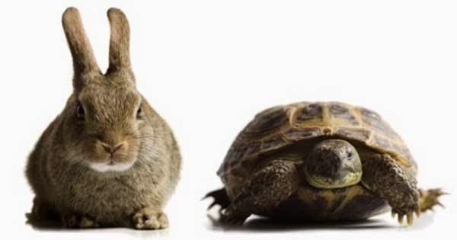
As soon as possible
@DaveGonzoKelly
This Photo by Unknown Author is licensed under CC BY-NC-ND

Slide 33
As soon as possible
A.S.A.P.
@DaveGonzoKelly
This Photo by Unknown Author is licensed under CC BY-NC-ND

Slide 34
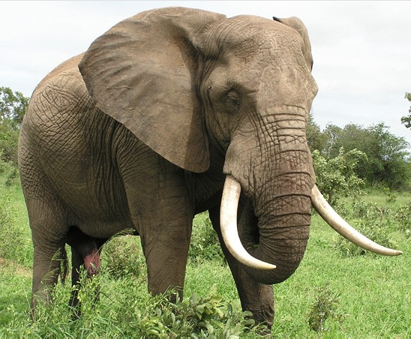
How do you eat an elephant?
This Photo by Unknown Author is licensed under CC BY-SA
@DaveGonzoKelly

Slide 35
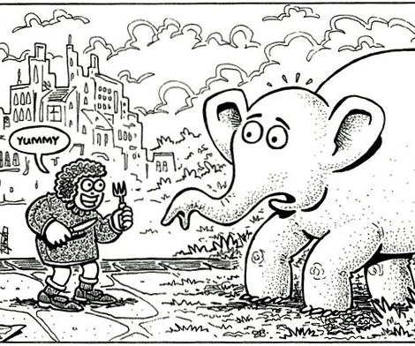
One bite at a time!
This Photo by Unknown Author is licensed under CC BY-SA-NC

Slide 36

Q&A
This Photo by Unknown Author is licensed under CC BY
@DaveGonzoKelly | Best Practices in Student Leadership | 36

Slide 37

Thank you! www.DaveGonzoKelly.com
DaveKelly@GonzoSpeaks.com
404-403-1481
This Photo by Unknown Author is licensed under CC BY

