Slide 1

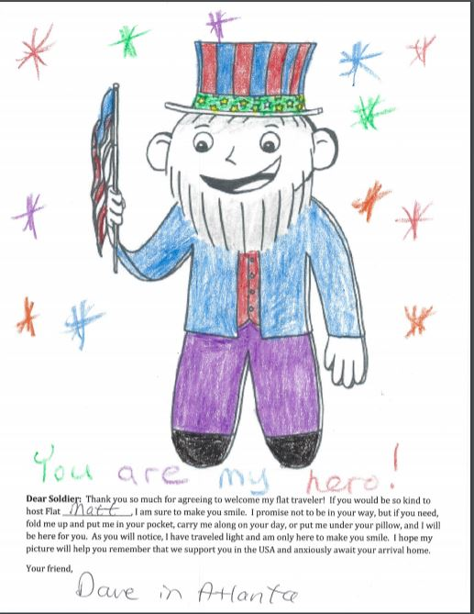

Slide 2
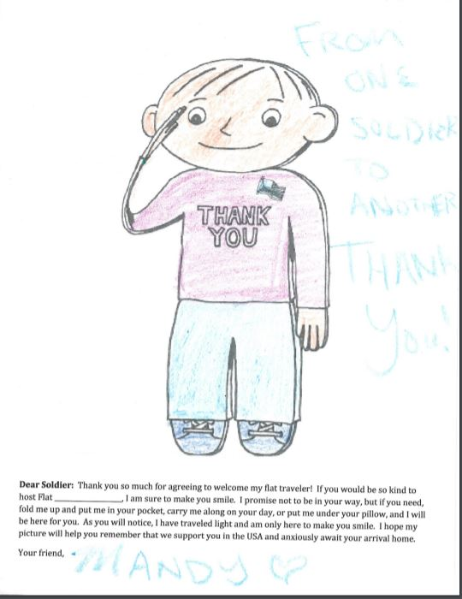

Slide 3
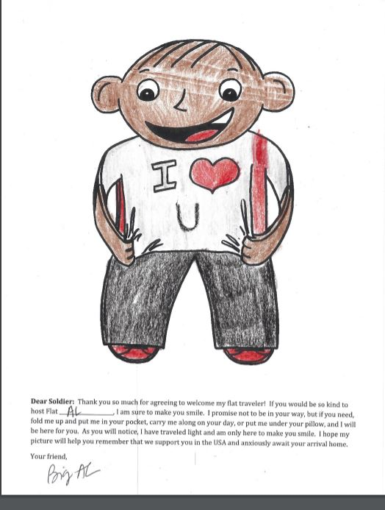

Slide 4
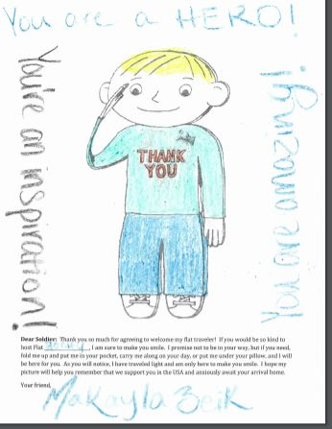

Slide 5
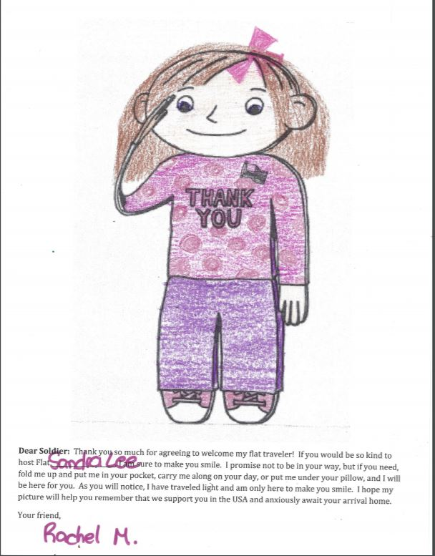

Slide 6
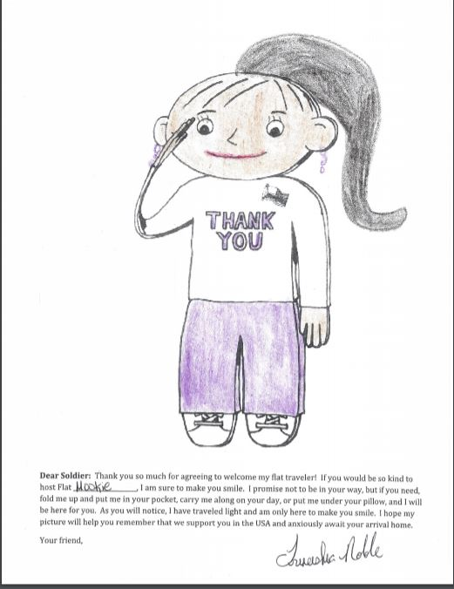

Slide 7
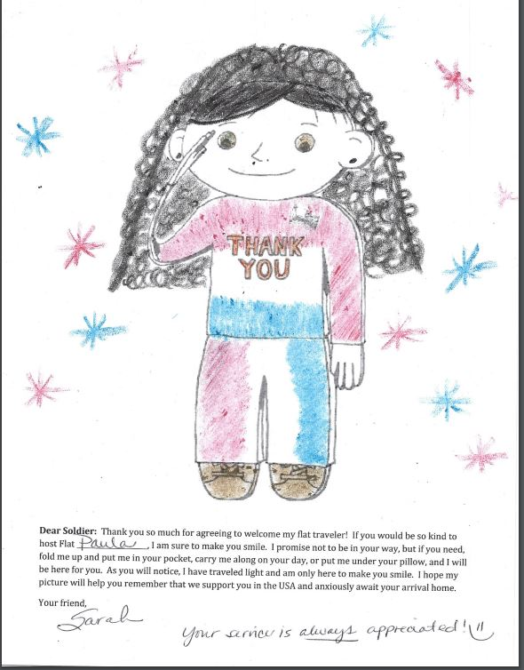

Slide 8
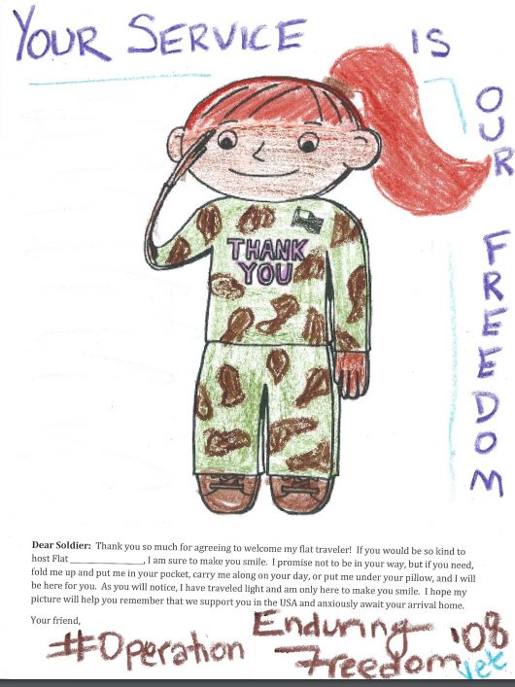

Slide 9
Operation Gratitude
https://www.OperationGratitude.com/

Slide 10
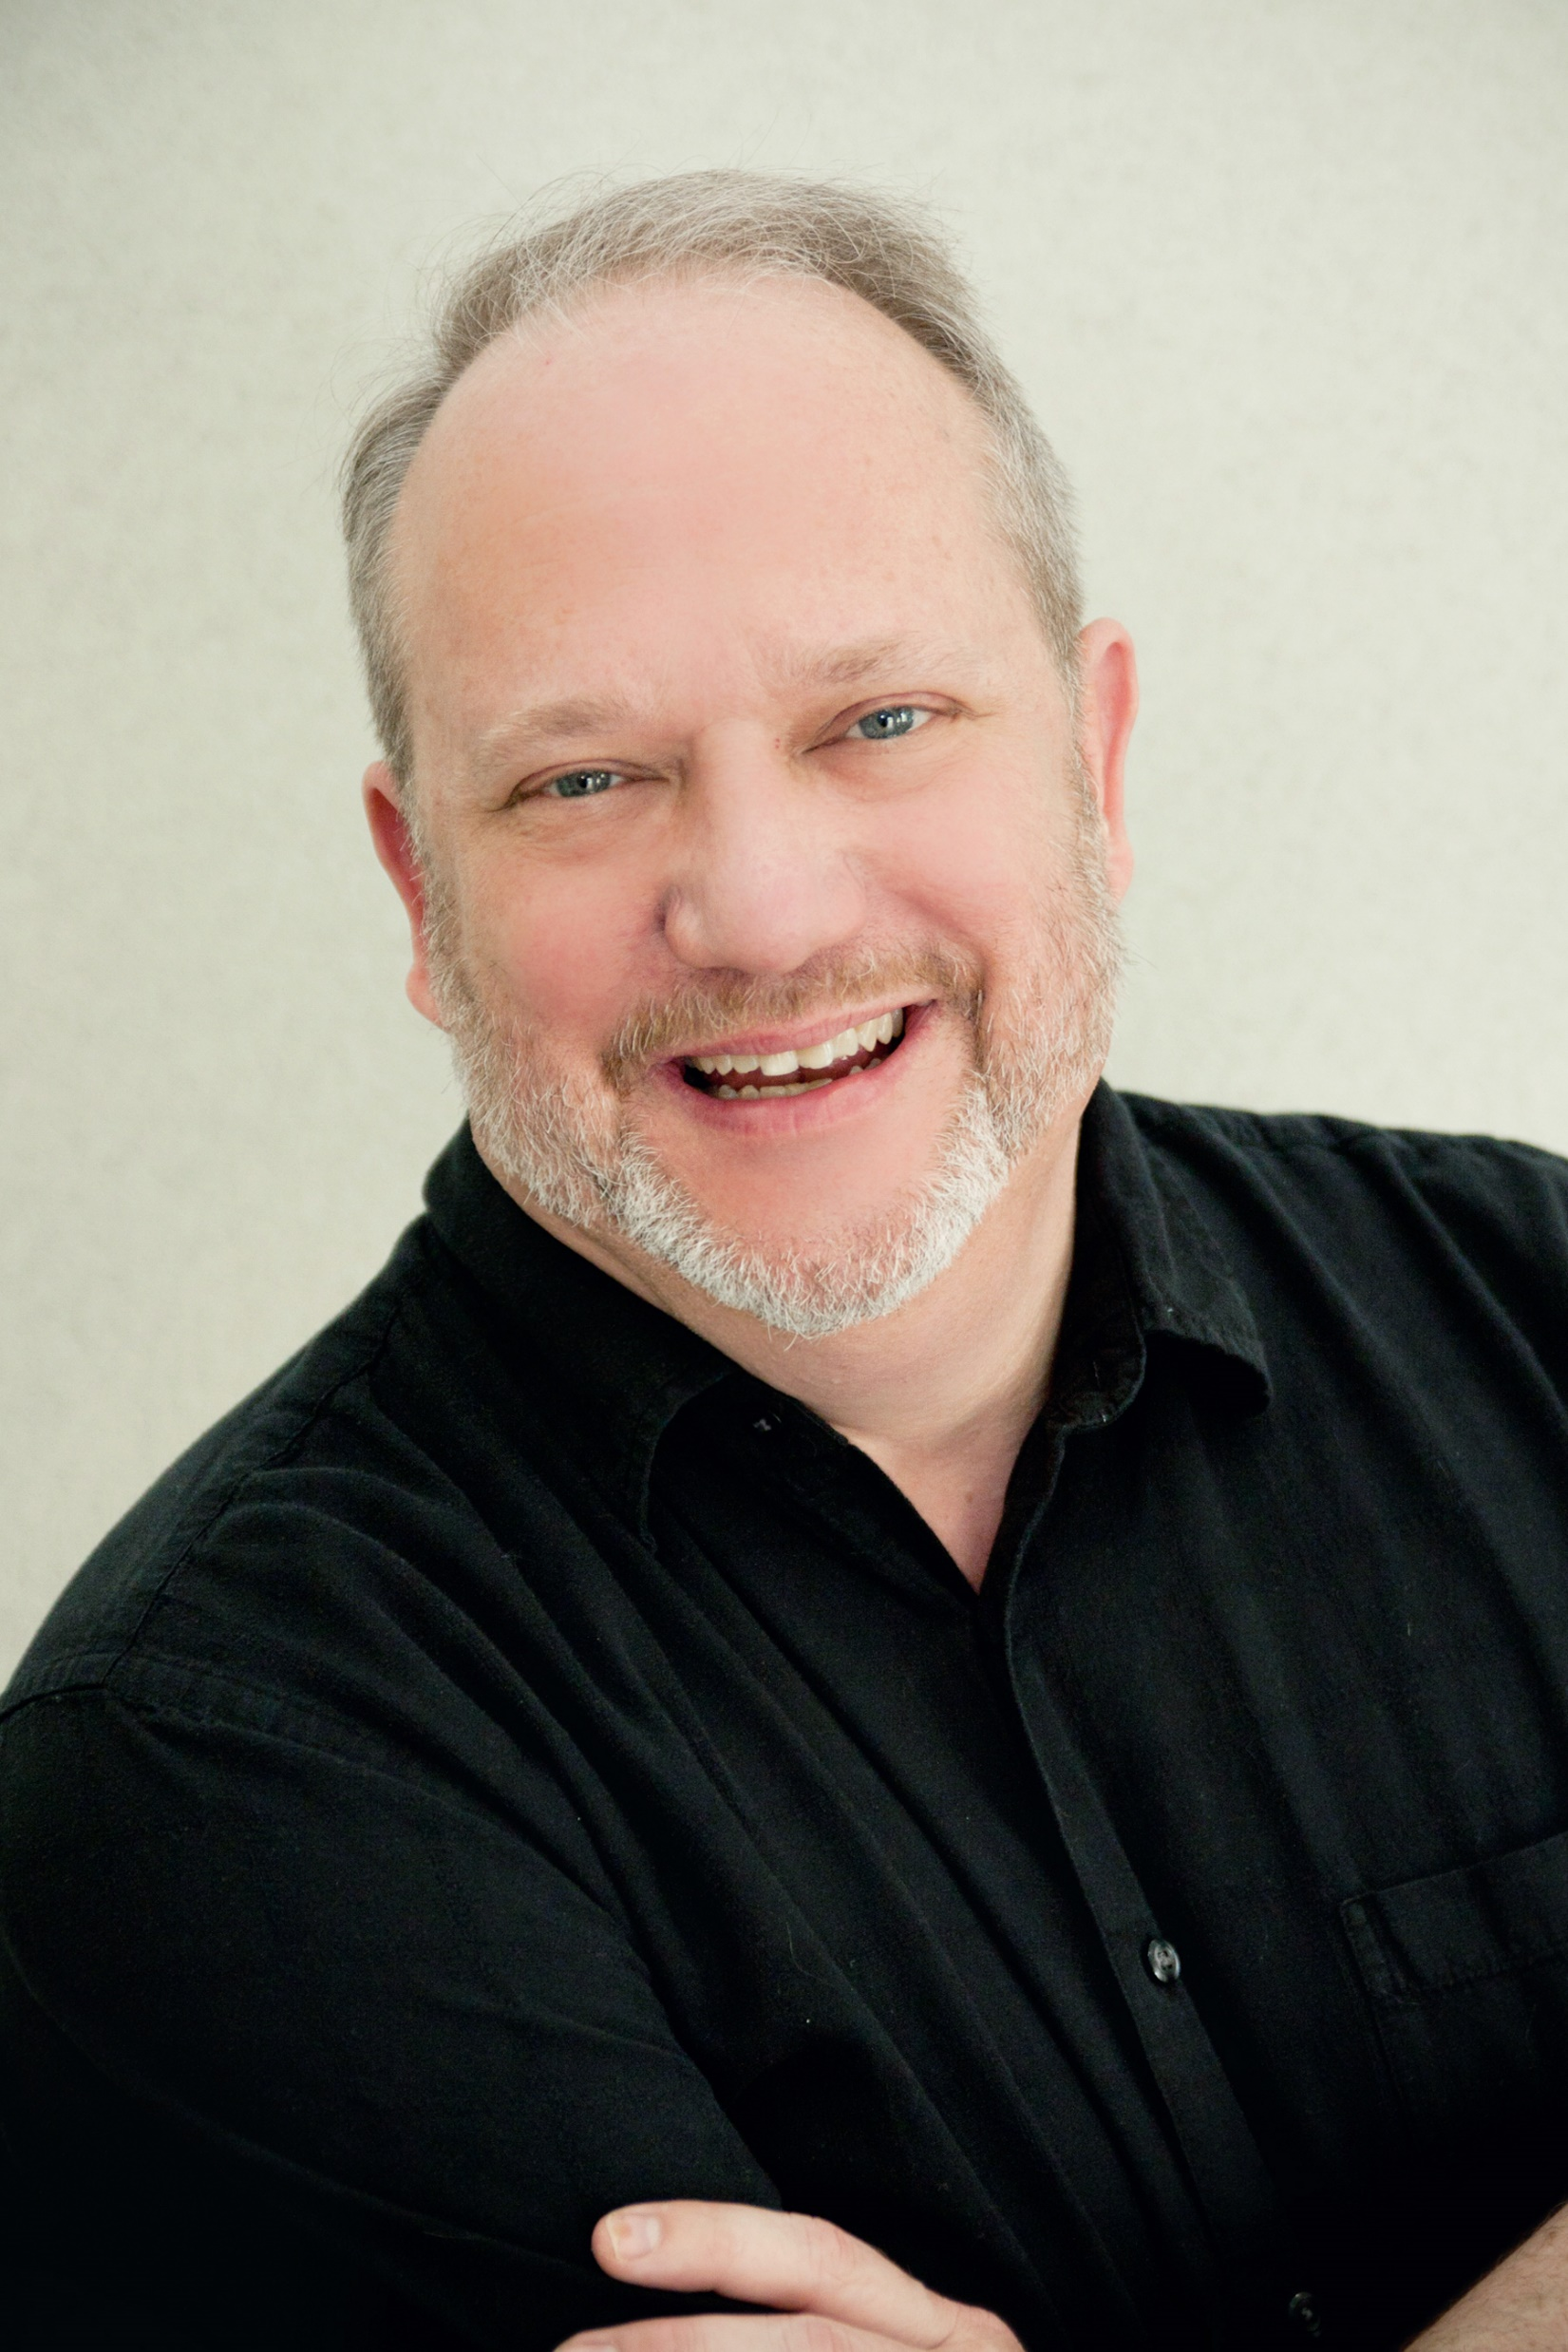
Dave Kelly
America’s Student Leadership Trainer
www.DaveGonzoKelly.com
DaveKelly@GonzoSpeaks.com
770-552-6592 (office)
404-403-1481 (cell/text) _______________________________________________
Ask about my special Virtual-Only
Student Leadership Workshop Series
4 sessions over the semester/$2000 $1800 total!

