Slide 1

DECAL's Community Response to Child Care Needs
Bridgette Washington
February 24, 2021
Kiwanis Lunch Meeting

Slide 2





Georgia Department of Early Care and Learning
Our Mission: Bright from the Start: Georgia Department of Early Care and Learning (DECAL) enhances children’s early education experience to promote their academic, social-emotional, and physical development in partnership with families, communities, the early care and education industry, and stakeholders.

Slide 3



Why is Early Childhood Education Important?
“85-90% of brain development takes place from birth to age five”
Children who enter kindergarten ready to succeed are more likely to read on grade level by third grade, graduate from high school, go on to college, and be productive members of the workforce.
Early care and education generates $4.7 billion
of economic activity in Georgia.
Source: 2016 Economic Impact Study
Notes:
https://www.rauchfoundation.org/what-we-support/children-and-families/
https://www.aecf.org/resources/early-warning-confirmed/

Slide 4


What Does DECAL Do?
Child Care Services
Georgia’s Pre-K Program
Childcare and Parent Services
Quality Rated Child Care
Nutrition Services
Research
Head Start Collaboration Office
Inclusion and Behavior Support Services
Infant Toddler Program
Professional Learning
Georgia Foundation for Early Care and Learning

Slide 5


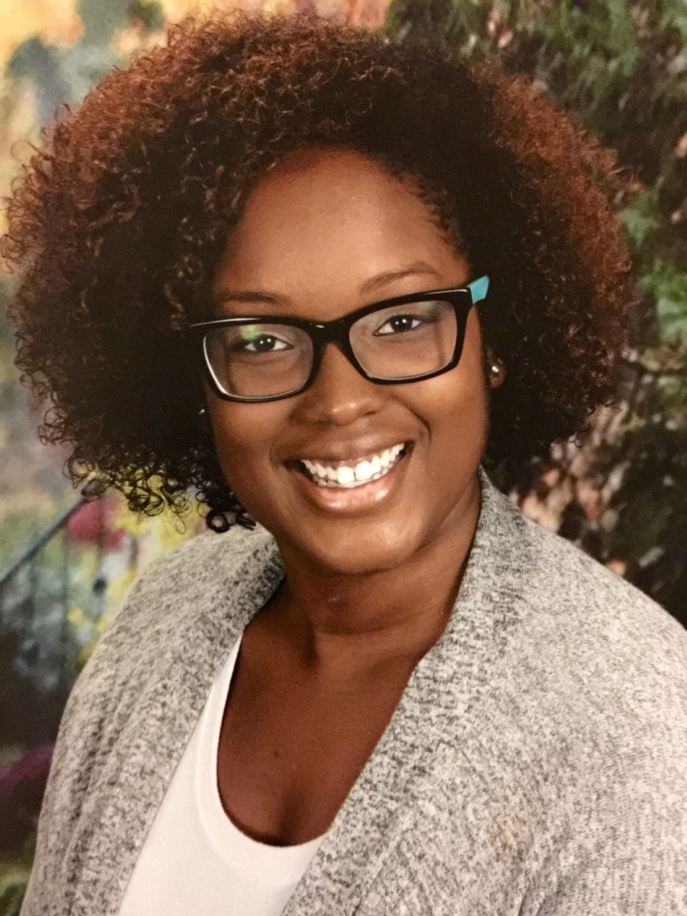


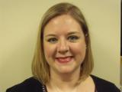


North East
Clayton Adams
Lead Coordinator
North West
Glenda Davis-Canteen
Central East
Jasmin Godding
Central West
Bridgette Washington
South West
Edward Rowell
South East
Kati Cosby
Laura Wagner, Quality Rated Policy & Partnerships Director
Jill O’Meara, Early Education Community Partnership Director

Slide 6
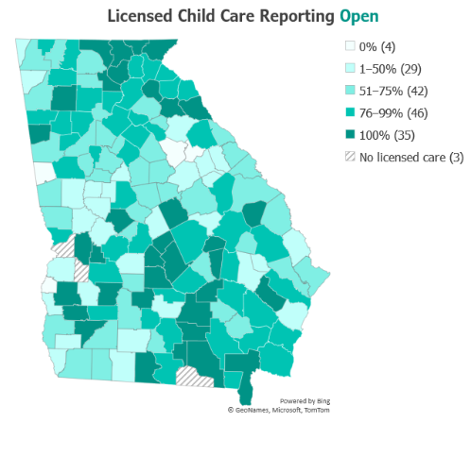
74%
Licensed Child Care Reporting Open in Georgia
http://www.decal.ga.gov/BFTS/Covid19.aspx
DECAL Administrative Data as of 8/31/2020

Slide 7
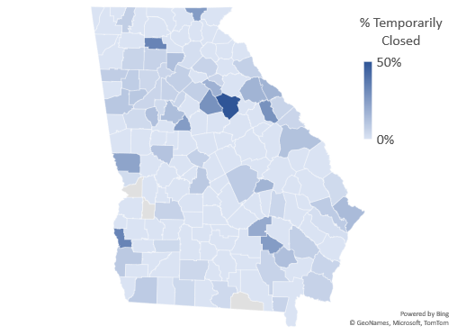
Current Landscape of Child Care
256 licensed providers (5.6%) are currently reporting a temporary closure from 61 counties.
Public health emergency and an incidence of COVID are the most common closure reasons.
Research & Policy Analysis
DECAL administrative data. Provider status as of 1/25/2021

Slide 8
DECAL’s Pandemic Response
COVID-19 webpage and FAQs continuously
Continuous communication with providers, families, and communities
  Podcasts
  Webinars
  Social Media
  Child Care Engagement Networks (2-tier approach)
    Monthly Virtual Meetings
    Bi-Monthly Newsletters
  Birth to Eight Meetings
Tracking program closures and other COVID-19 related data
Suspended on-site visits
  CCS conducting virtual licensing visits
  Quality Rated piloting alternative rating options
Continuing Childcare and Parent Services (CAPS) payments
Summer Feeding Service Program
  Serving Meals during Unanticipated School Closures
Funding opportunities
Notes:
Additional talking points: DECAL (Georgia Department of Early Care and Learning) and DPH (Georgia Department of Public Health) partnered to develop Guidance for Georgia Child Care Facilities resource to support child care programs.
A total of 1847 child care providers, educators, and community partners attended a Collaborating for Childhood Resilience in Early Care and Learning 2020 Virtual Summit.

Slide 9
STABLE
Short Term Assistance Benefit for Licensed Entities
DECAL has awarded over $92 million in CARES funding to licensed child care programs in Georgia impacted by COVID-19.
  The first round (May 2020) DECAL awarded more than $38.8 million in financial support to 3,789 licensed child care providers.
  The second round (December 2020) DECAL awarded more than $54 million in financial supports to 3,677 providers.
http://www.decal.ga.gov/documents/attachments/release_STABLE%20Update%2012-14-2020.pdf
Notes:
“We know that family child care learning homes and child care learning centers in Georgia are struggling as a result of COVID-19,” said Commissioner Jacobs. “To expedite these payments, we developed a simple application asked for attendance by age and by program, including the CAPS program and Georgia’s Pre-K Program.” www.decal.ga.gov Throughout the COVID-19 crisis, Governor Brian P. Kemp has allowed licensed child care to remain open to serve children and families. However, with more families staying at home, child care attendance significantly declined except for children of first responders and essential workers.

Slide 10
SOLVE
Supporting Onsite Learning for Virtual Education
Funding Between $17 and $19 million provided by Governor Kemp’s Office in part of the Governor’s Emergency Education Relief (GEER) funding.
Provides financial assistance for school age students of public school systems that are using a virtual-only learning model and/or if there is an in-person option, it is 50% or less of the time.
Scholarships help pay for care, supervision, and support during the school day for students engaged in virtual learning and are enrolled in child care while parents work.
https://www.decal.ga.gov/CAPS/Solve.aspx .
Notes:
Governors Relief Emergency Care Funding - This funding is allocated to Georgia through the CARES Act and is in response to the COVID-19 Public Health Emergency
https://www.decal.ga.gov/CAPS/Solve.aspx
Questions? Call us at 1-833-442-2277, Go to our Contact Us page, or E-mail solve@decal.ga.gov

Slide 11
CRRSA Funding & Early Learning
DECAL has received funds from the federal Coronavirus Response and Relief Supplemental Appropriations Act (CRRSA). ﻿
DECAL will distribute the funding in phases.
The Phase 1 plan includes:
Round 3 STABLE Payments for ECE Providers
Supplemental Payment to the ECE workforce
Support for CAPS Families
Competitive grant for programs serving school-age children
Notes:
DECAL proposed a plan for distributing one-time payments to help mitigate the negative financial impact of the COVID-19 pandemic on Georgia’s child care industry and to help eligible Georgia families (also negatively impacted by the pandemic) pay for child care.

Slide 12
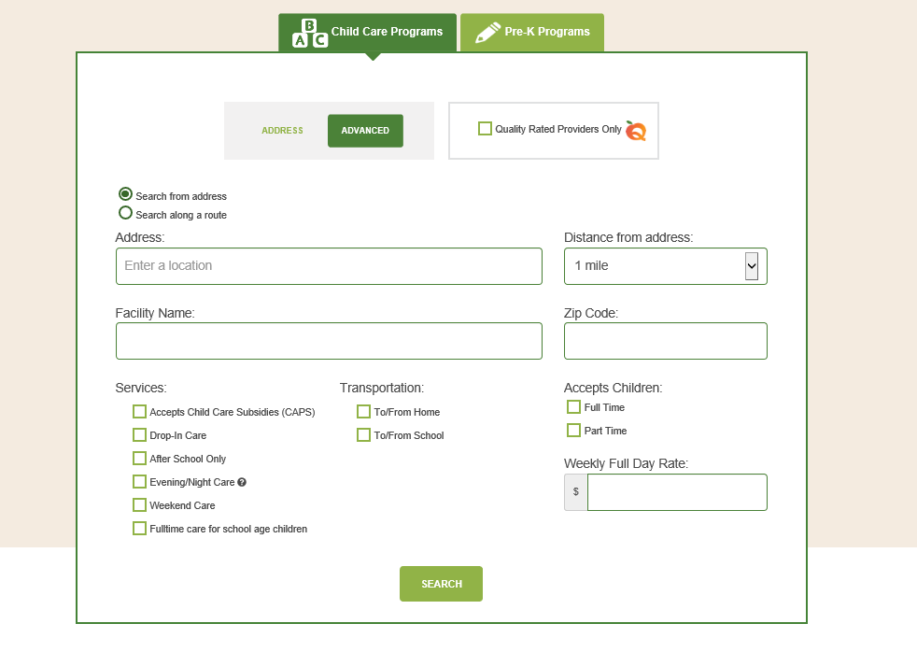
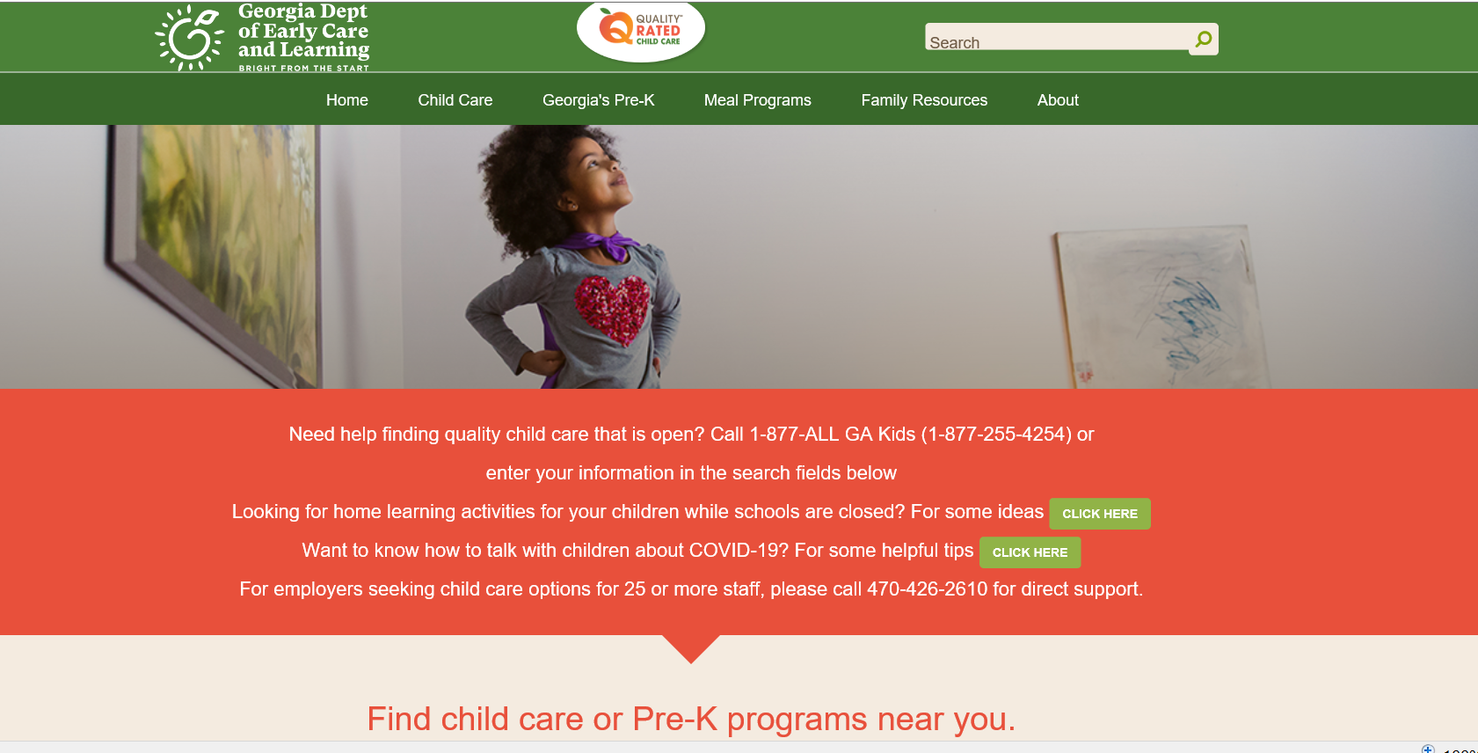
http://qualityrated.org
Notes:
1-877-ALL-GA-KIDS

Slide 13
Child Care Challenges in Your Community

Slide 14
How Do You Stay Connected To Early Learning Resources in Your Community?

Slide 15


How YOU Can
Support Your Local Community
Continue to communicate the importance of access to high-quality care
Check in with local programs about their needs during the pandemic
Direct families and programs to DECAL resources, such as CAPS and SOLVE scholarships
Join a Birth to Eight Meeting
Notes:
2021 Central West B-8 Quarterly Meetings: April 14^{th -} August 11^{th &} November 10th

Slide 16


Thank You!
Bridgette Washington
(404) 463-0663
Bridgette.Washington@decal.ga.gov
Notes:
Feel free to reach out to me anytime with questions or requests for information and resources.

