Slide 1

Closing the Sale: Recruiting a Ton of Members
2025 APCA Nationals
Dave Kelly
America’s Student
Leadership Trainer^{sm}
This Photo by Unknown Author is licensed under CC BY-SA

Slide 2
Conducting a Successful Recruitment Table
Have you ever
seen this…?
@DaveGonzoKelly

Slide 3
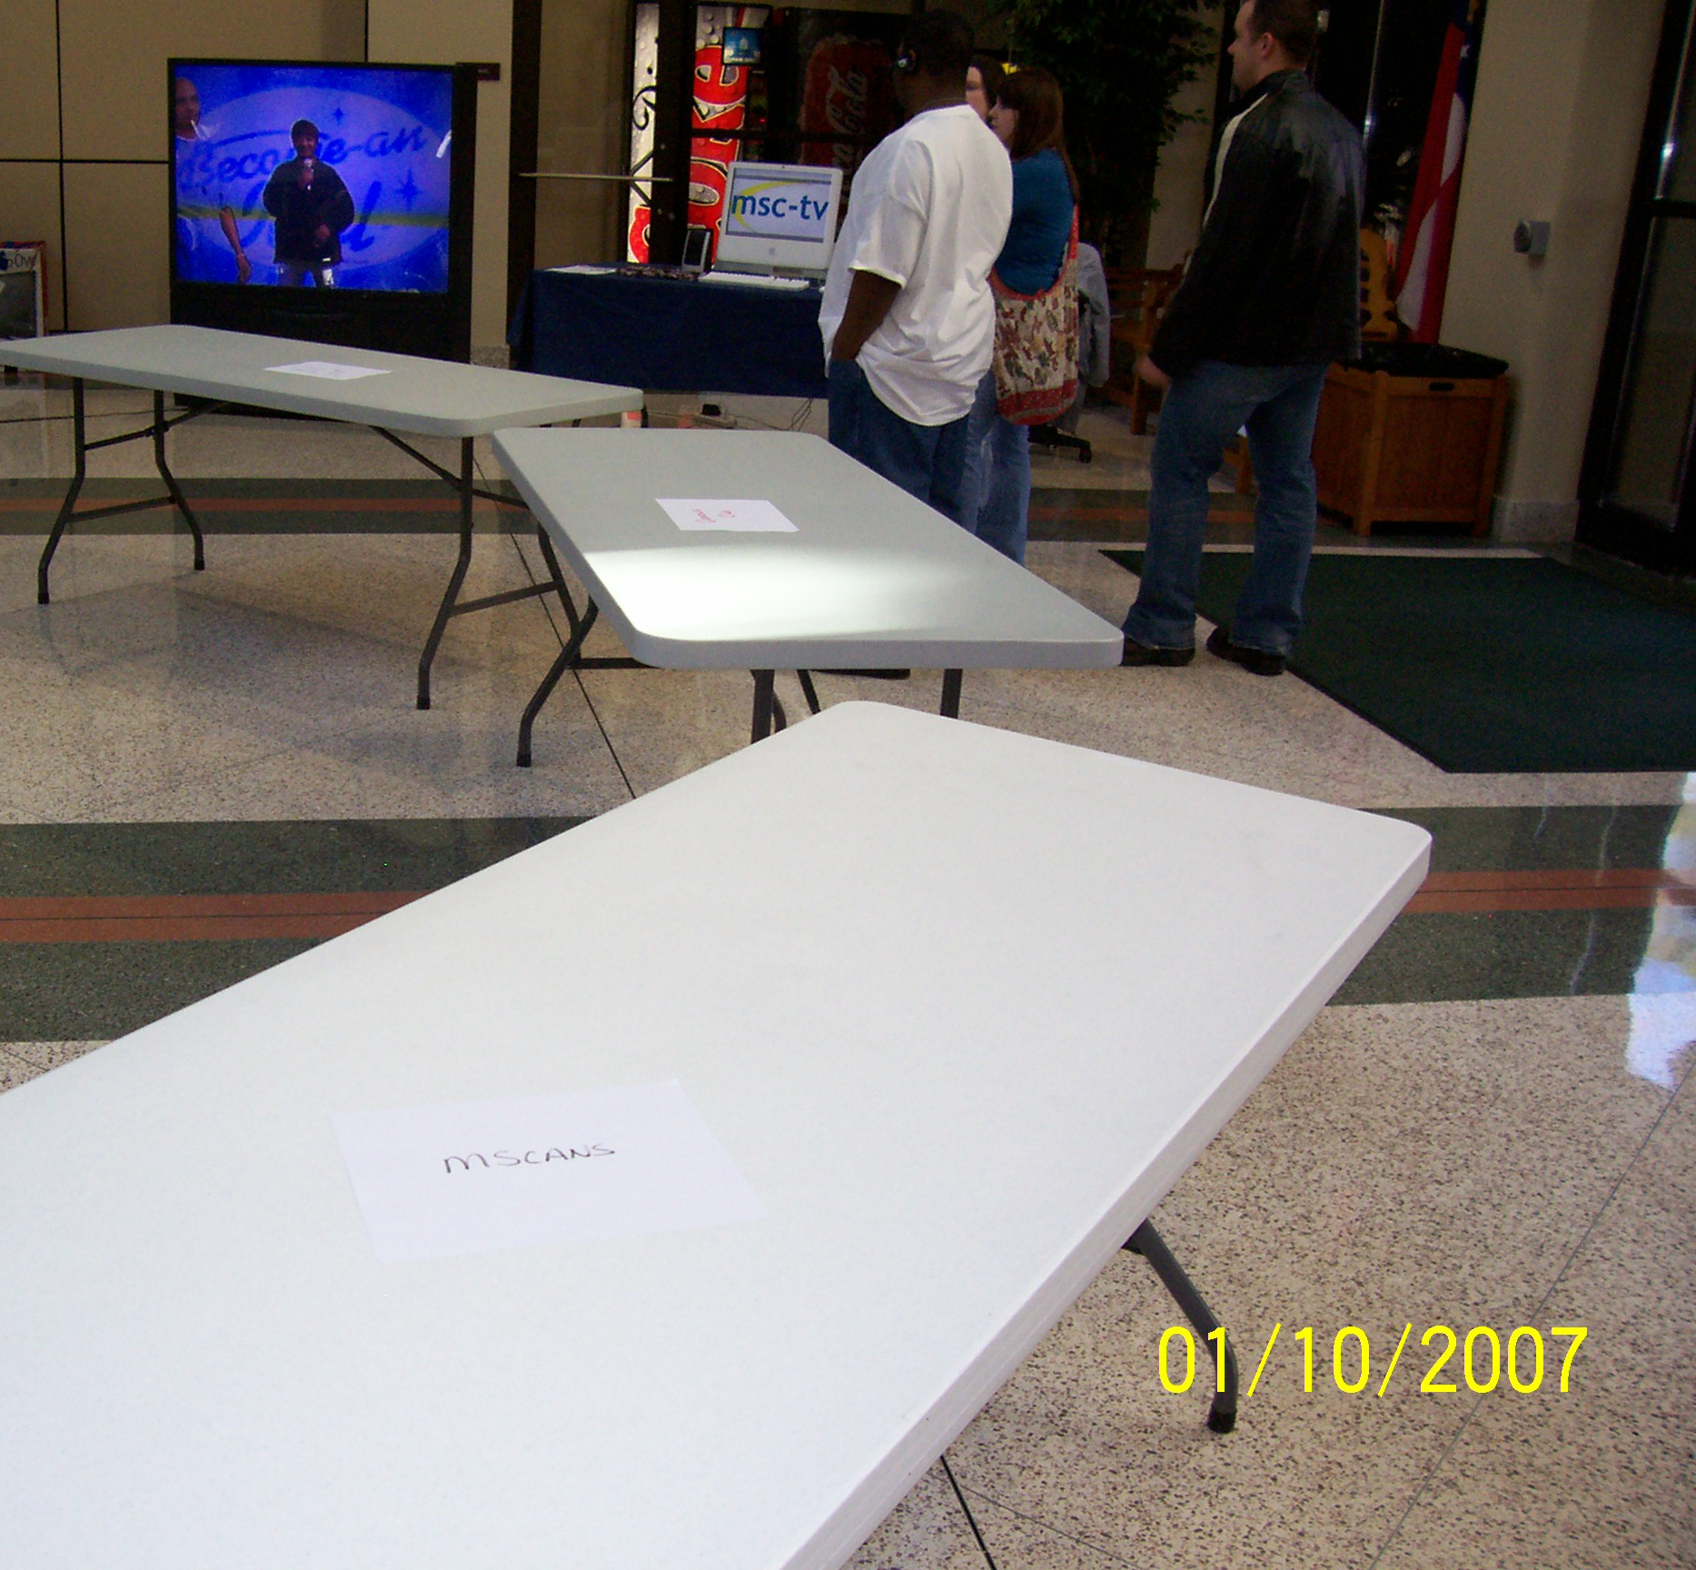
Conducting a Successful Recruitment Table
Have you ever
seen this…?
@DaveGonzoKelly

Slide 4
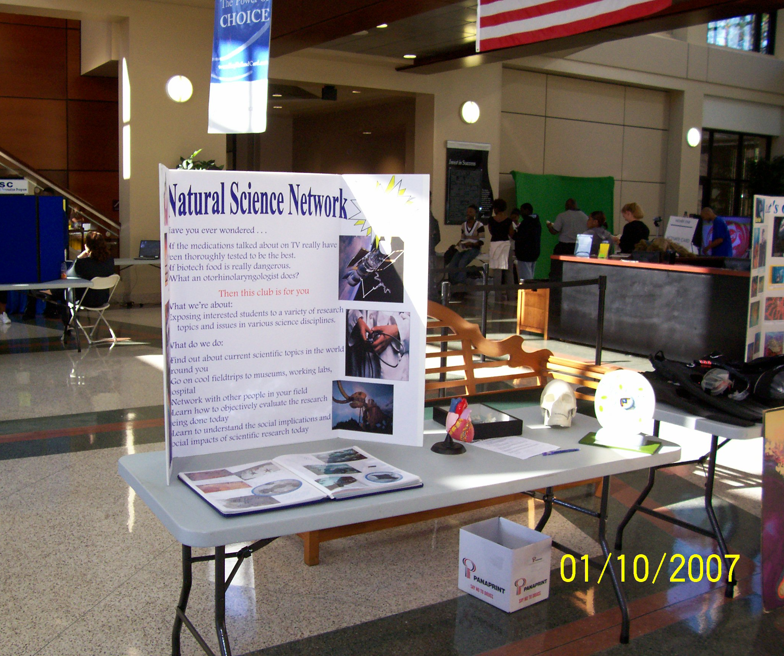
Conducting a Successful Recruitment Table
@DaveGonzoKelly

Slide 5
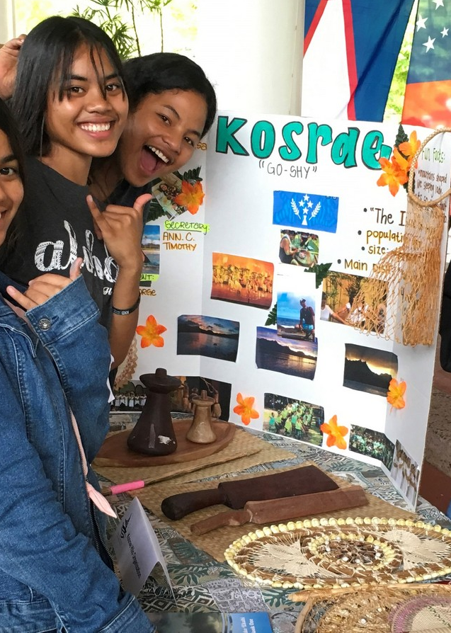
Conducting a Successful Recruitment Session
No chairs!
Show off your club (tri-boards, scrapbooks, videos).
Wear proper attire (t-shirts) or a coordinated look.
Several members should participate. (at least 3)
Have a defining statement or question:
(write yours in the space provided)
@DaveGonzoKelly
This Photo by Unknown Author is licensed under CC BY
This Photo by Unknown Author is licensed under CC BY

Slide 6

Elements of a Successful Recruitment Session
Sign-up sheet information – Use sheets, tablets, or QR Codes to a Google Doc or similar platform. Get this info:
  Student name
  Class Status
  Phone number
  E-mail address
  Areas of interest
  Pens!
This Photo by Unknown Author is licensed under CC BY-NC-ND
@DaveGonzoKelly

Slide 7

Elements of a Successful Recruitment Session
Create and informational flyer. It should contain the following:
  Description of the organization
  List of activities, programs, and ways to be involved.
  List of typical members
  List of contacts within the organization
  (including the advisor)
  Web-site/social media addresses
  Meeting day, time, and place/platform
This Photo by Unknown Author is licensed under CC BY-SA-NC
@DaveGonzoKelly

Slide 8
Sample Information
Flyer
@DaveGonzoKelly

Slide 9
Sample Information
Flyer
@DaveGonzoKelly

Slide 10

Elements of a Successful Table
Display banner or flag.
@DaveGonzoKelly
This Photo by Unknown Author is licensed under CC BY-SA

Slide 11

Elements of a Successful Table
Candy!
This Photo by Unknown Author is licensed under CC BY-NC-ND
@DaveGonzoKelly

Slide 12

Follow-Up on the
Recruitment Session
Everyone who signed up should receive a message that same night with your flyer attached.
Invite them to the information meeting.
Before information meeting, contact to remind of meeting date, time, place, and to invite them to attend.
@DaveGonzoKelly

Slide 13
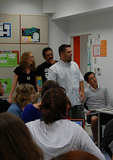
The Informational Meeting
Campus organizations that show a real interest in obtaining a student’s involvement are better poised to get them as a member.
Provide a virtual participation option for on-line only students, people who cannot be on campus during the meeting, and to record it for those who cannot attend live.
This Photo by Unknown Author is licensed under CC BY-SA-NC
@DaveGonzoKelly

Slide 14

Successful Informational Meetings
Have dedicated people handle the logistical aspects.
Greet all attendees as they enter the meeting.
Pair them with a returning member(s), perhaps use a breakout room.
All officers, advisors, and members introduce themselves.
Have an ice-breaker to get people mingling virtually and in-person.
@DaveGonzoKelly

Slide 15
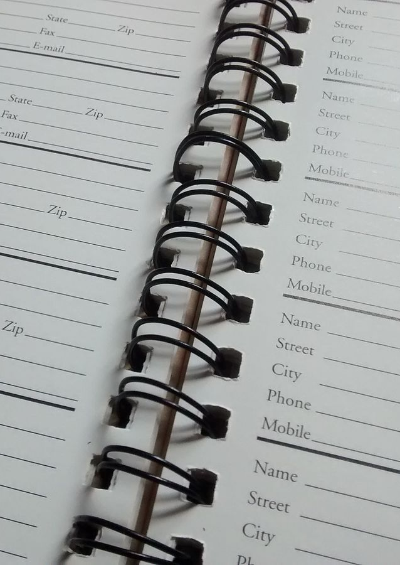
Successful Informational Meetings
Get contact and background information through an application or similar format.
(All sources of contact: home phone, cell phone, all email addresses, school mailing address, home mailing address, and social media. Get high school and community activities.)
@DaveGonzoKelly
This Photo by Unknown Author is licensed under CC BY-SA

Slide 16
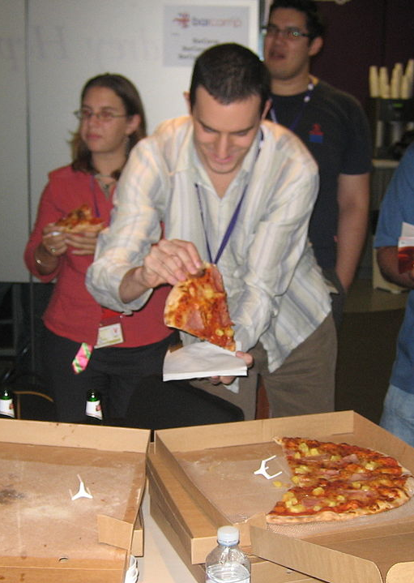
Successful Informational Meetings
Food!
This Photo by Unknown Author is licensed under CC BY-SA
@DaveGonzoKelly

Slide 17

Membership Invitation Program
Ask
Ask faculty (or high school counselors for incoming students) to nominate students for certain types of clubs and orgs, or even specific groups like student government.
Send
Send a letter to the student letting them know they have been nominated and invite them to join.
Down
load
Download a free template at
https://bit.ly/30vZYXD
@DaveGonzoKelly
This Photo by Unknown Author is licensed under CC BY-ND

Slide 18
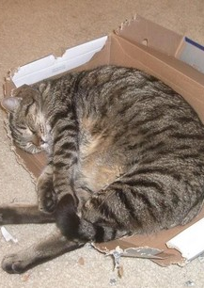
Think Outside the Box
Ask the Office of Admissions to assist in contacting students for certain types of clubs and orgs, or even specific groups like student government.
Be creative in making contact.
Show what you do, such as performing a service project.
Don’t overlook the importance of virtual recruitment!
@DaveGonzoKelly
This Photo by Unknown Author is licensed under CC BY-SA

Slide 19
Don’t forget about recruiting in the spring!

Slide 20
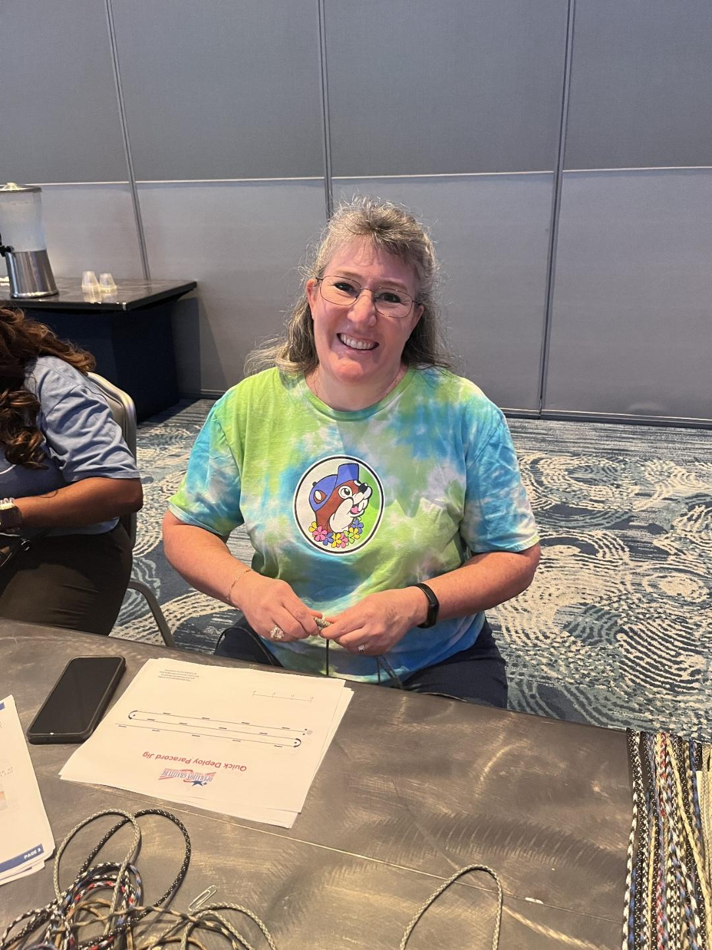
Don’t forget about recruiting in the spring!

Slide 21
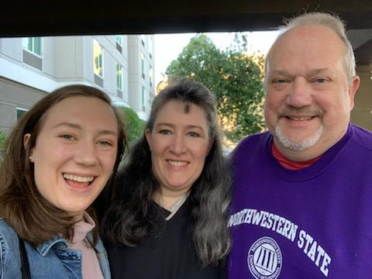
Don’t forget about recruiting in the spring!

Slide 22

Other ideas??

Slide 23

Q&A
This Photo by Unknown Author is licensed under CC BY

Slide 24

Thank you! www.DaveGonzoKelly.com
DaveKelly@GonzoSpeaks.com
404-403-1481 Cell/Text
@DaveGonzoKelly
This Photo by Unknown Author is licensed under CC BY

