Slide 1
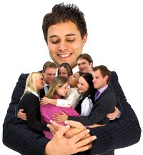
Membership Retention:
Keeping Students Engaged in Campus Organizations
UTRGV 2020 LEAD Conference
This Photo by Unknown Author is licensed under CC BY-SA-NC
Dave Kelly
America’s Student Leadership Trainer^{sm}

Slide 2
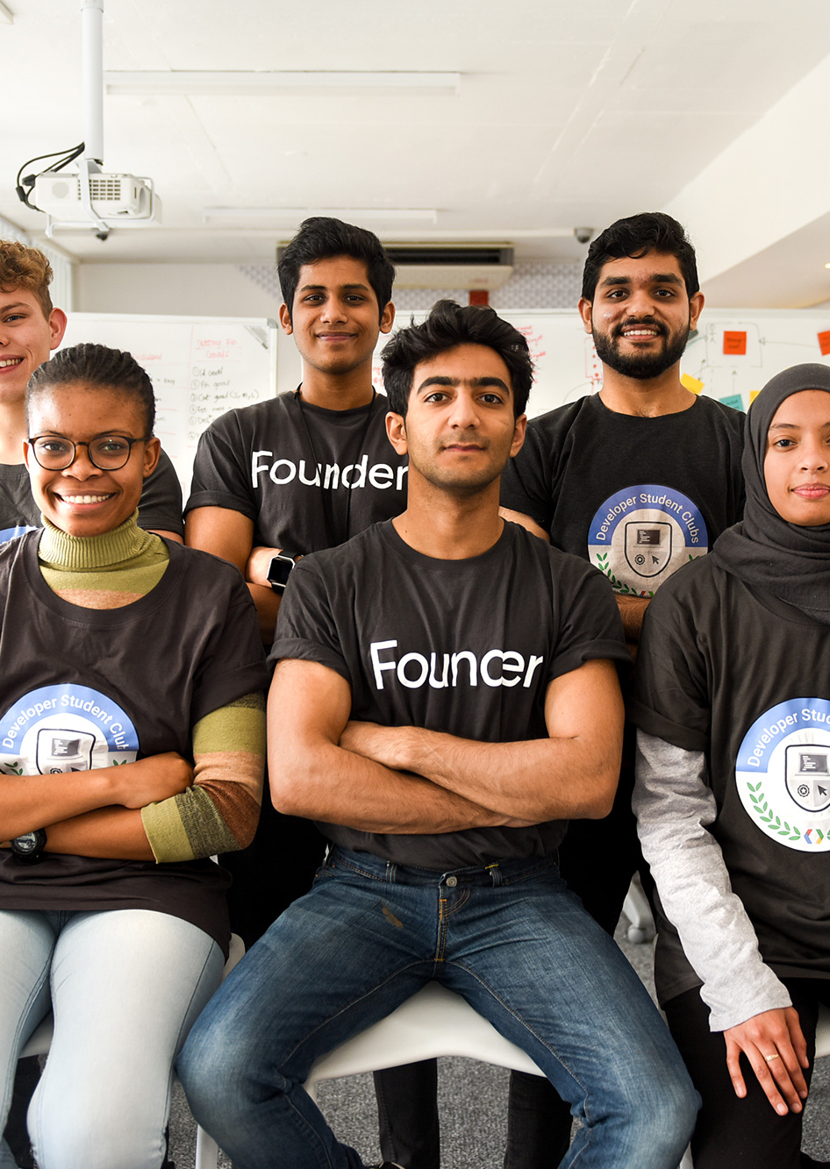
Membership Retention
This Photo by Unknown Author is licensed under CC BY-ND
Most Important Aspects of Your Organization:
Share in the chat with the name of your club/organization!

Slide 3
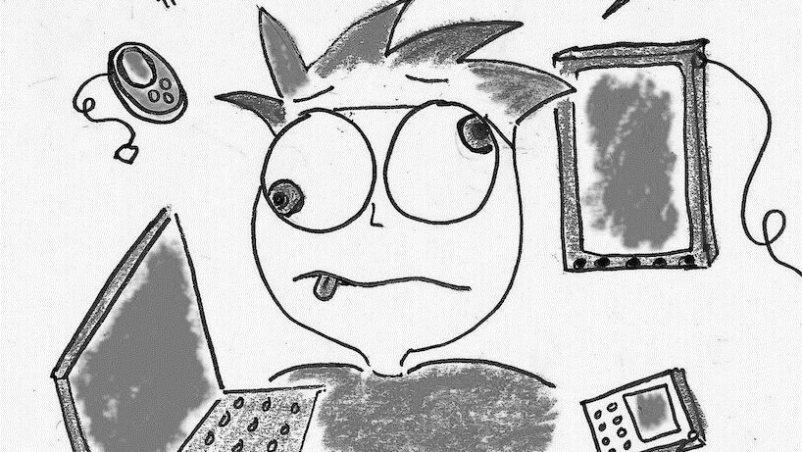
Issues Affection Retention
This Photo by Unknown Author is licensed under CC BY

Slide 4
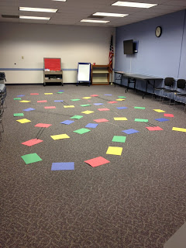
Issues Affection Retention
Meetings are boring or unproductive.
Make the meeting fun and interesting with lots of participation.
A greeter welcomes people to the meeting.
Have icebreakers to give the attendees a chance to meet other people.
This Photo by Unknown Author is licensed under CC BY-SA

Slide 5
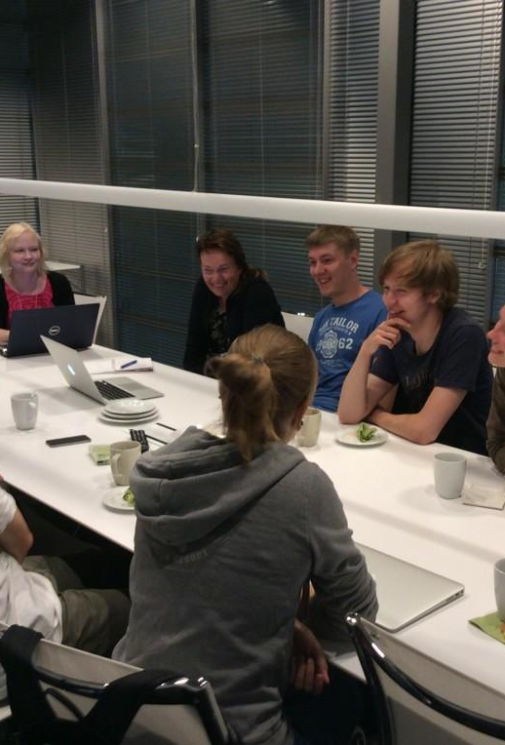
Issues Affection Retention
Call the meeting to order on time!
  Have music playing.
  Record the meeting and post it so members can access it later if they could attend live.
  Lead a group activity such as the Pledge of Allegiance.
This Photo by Unknown Author is licensed under CC BY

Slide 6


Slide 7

Issues Affection Retention
Recite club or organization pledge.
Have an invocation, humorous story, thought of the day, or this day in history.

Slide 8
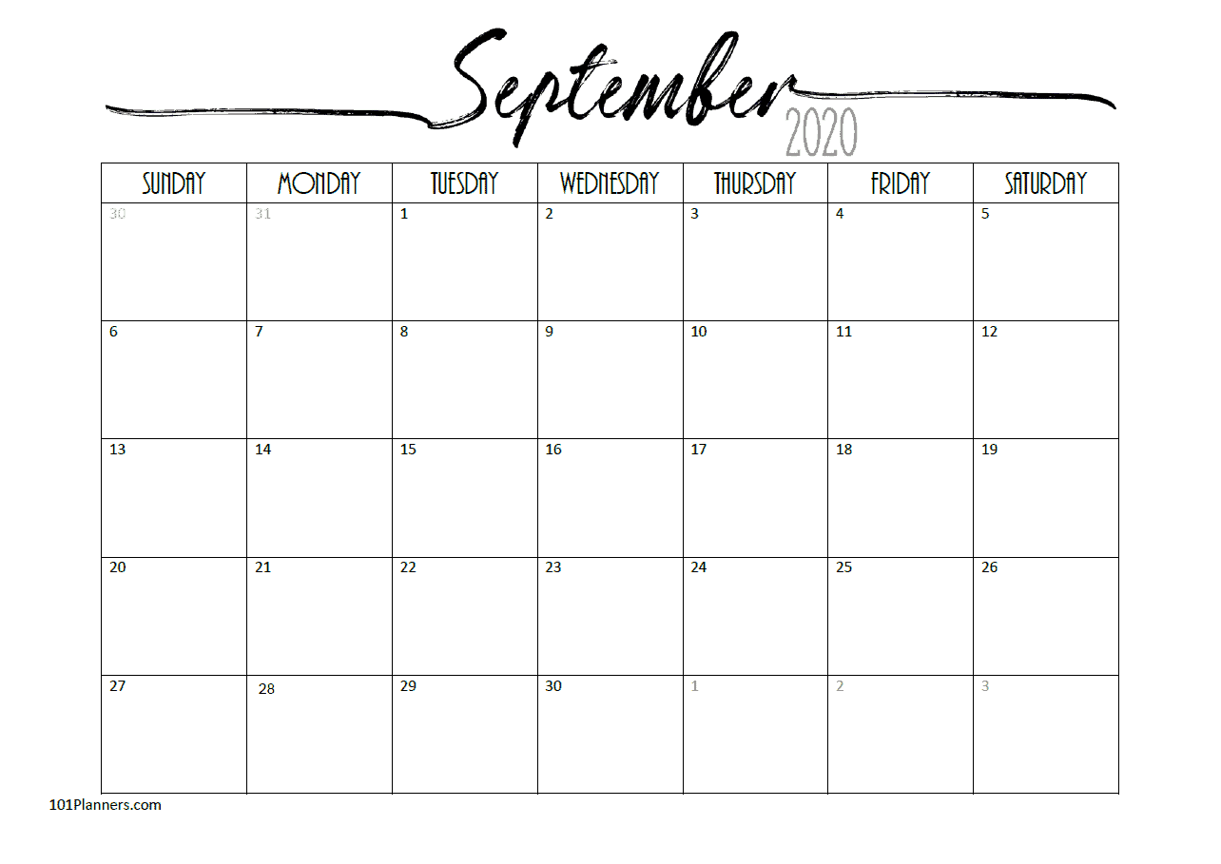
September 15 in history…
On this date in 1978, what athlete, became the first boxer to ever win the heavyweight title three separate times?
On this date in 1864, what major hub of transportation and supply lines fell to the Union Army?
Post your guesses in the chat.
This Photo by Unknown Author is licensed under CC BY-SA

Slide 9
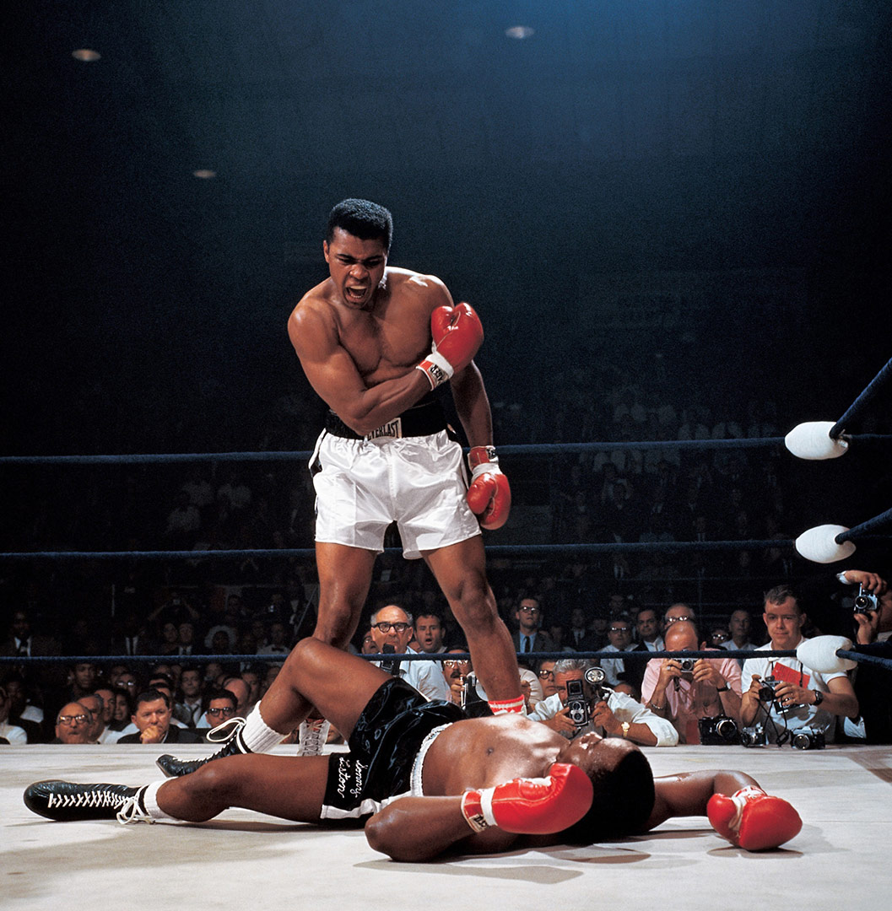
September 15 in history…
On this date in 1978, who became the first boxer to ever win the heavyweight title three separate times? The answer is…
Muhammed Ali!
He declared himself “The Greatest” and noted his style as “float like a butterfly, sting like a bee”.

Slide 10
September 15 in history…
In 1954, an iconic movie scene was filmed in which the skirt of a legendary actress was “blown-up” by a subway vent. Who was she?
Post your answers in the chat.
On this date in 1864, what major hub of transportation and supply lines fell to the Union Army?
Post your guesses in the chat.
This Photo by Unknown Author is licensed under CC BY-SA

Slide 11
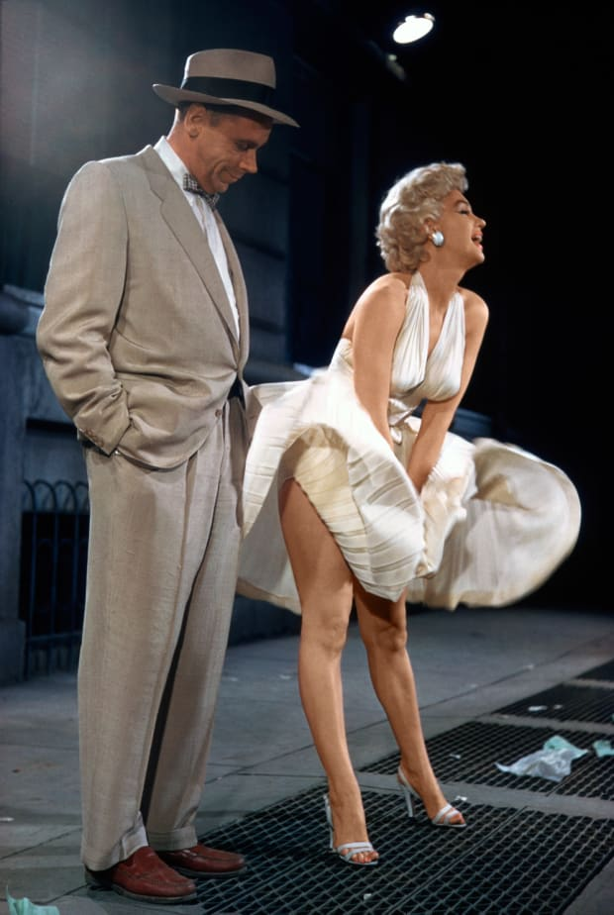
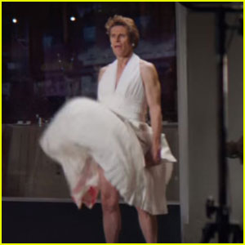
September 15 in history…
Marilyn Monroe! The movie was “The Seven Year Itch.”
The scene infuriated her husband, baseball Hall of Famer Joe DiMaggio, who felt it was exhibitionist. The couple divorced shortly thereafter.
The scene has been recreated in numerous films and TV shows and even a recent Snickers Super Bowl commercial with actor Willem Dafoe.

Slide 12
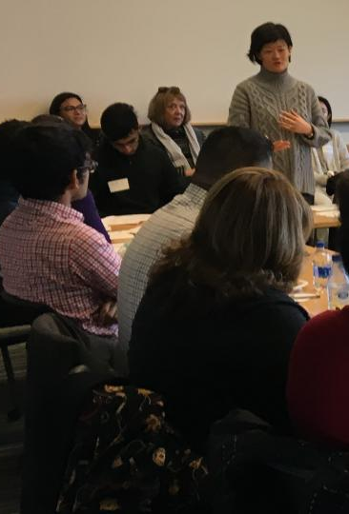
Issues Affection Retention
Offer member education in the form of the “membership minute”.
Give members an opportunity to talk about what is going on with them, share concerns, and express how they feel.
Officers report on their activities and items of interest.
Introduce special guests.
This Photo by Unknown Author is licensed under CC BY

Slide 13

Issues Affection Retention
Have the greeter introduce other guests and meeting visitors.
Committees report on their area of responsibility and upcoming activities.
Recognize birthdays, big accomplishments, milestones.
End the meeting on time.
This Photo by Unknown Author is licensed under CC BY

Slide 14

Issues Affection Retention
The organization is not what the student expected it to be.
This Photo by Unknown Author is licensed under CC BY-SA

Slide 15

Issues Affection Retention
Be honest and upfront regarding what the club/organization is about.
    (substance over image!)
This Photo by Unknown Author is licensed under CC BY-NC-ND

Slide 16


Slide 17
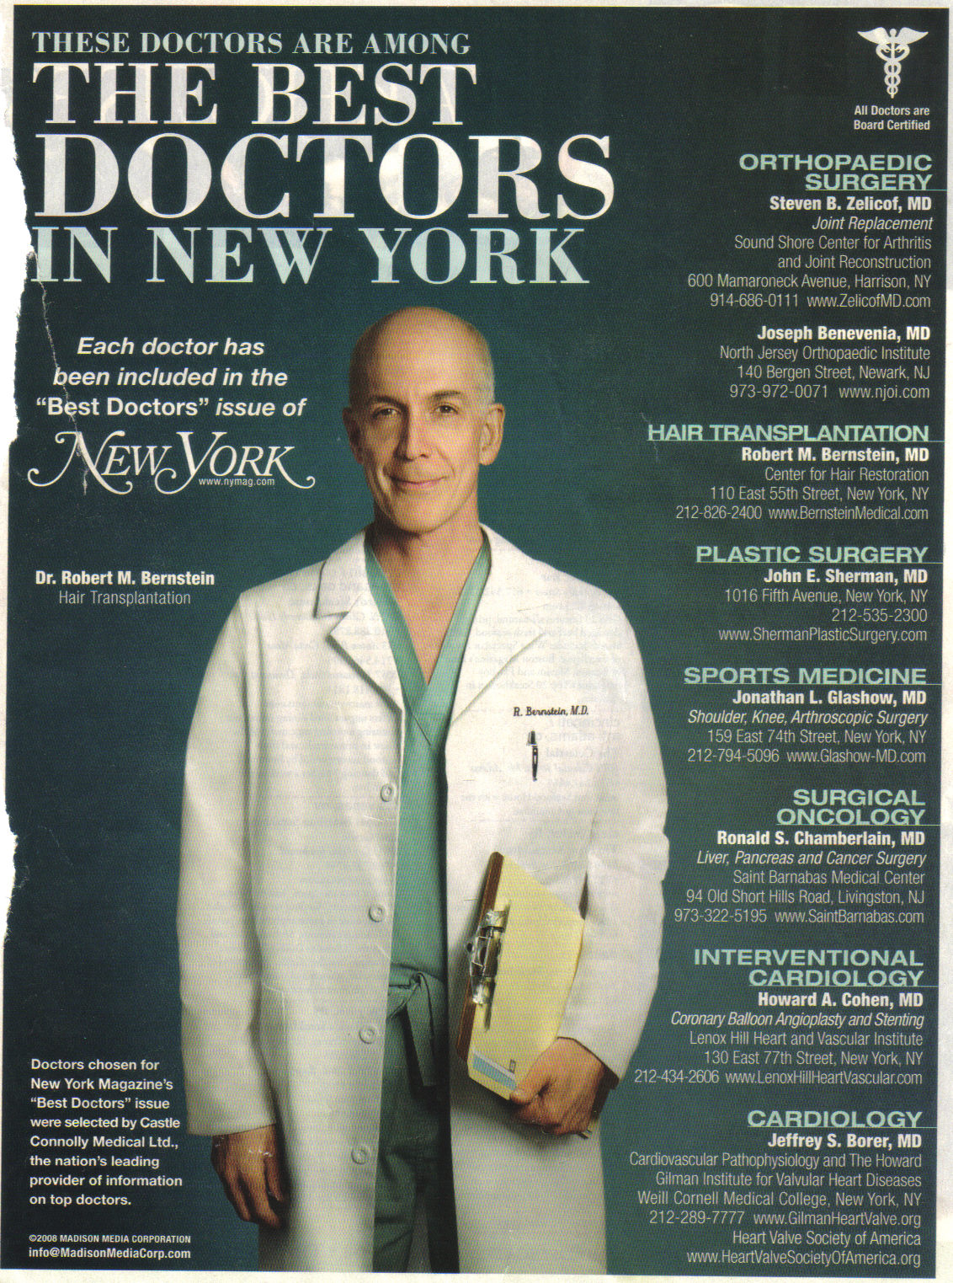

Slide 18
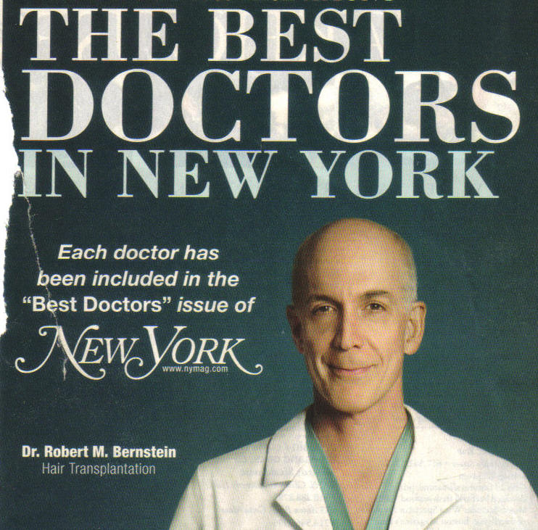
!

Slide 19

Issues Affection Retention
Be clear regarding expectations about meeting attendance and how much participation is required.
Have a varied menu of activities, some of which can include other family members and friends, such as service projects.
This Photo by Unknown Author is licensed under CC BY-NC-ND

Slide 20
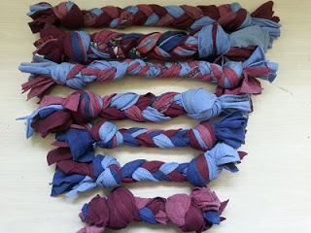
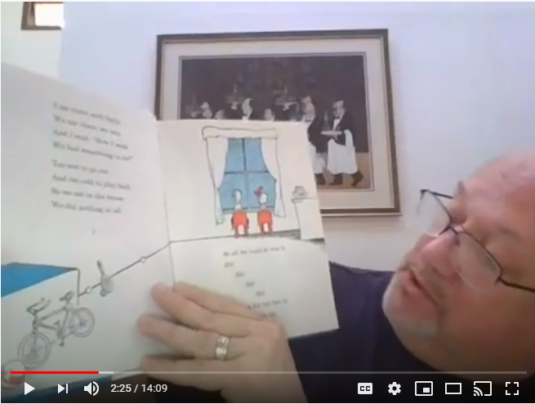
Service Anywhere!
Dog Toys
Story Time

Slide 21
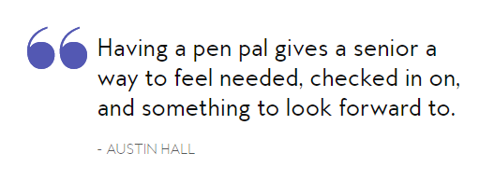

Nursing Home Pen-Pals
Contact a local nursing home and ask if they would be interested in developing a pen-pal program
Write letters to the residents
When times are better, visit the residents in person!

Slide 22
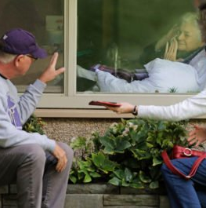
Adopt a Nursing Home
Senior pen-pals
Window visits
Window painting
Watch movies or play trivia on-line together
For more information, contact your local nursing homes to see what projects you can do together
This Photo by Unknown Author is licensed under CC BY-NC-ND

Slide 23
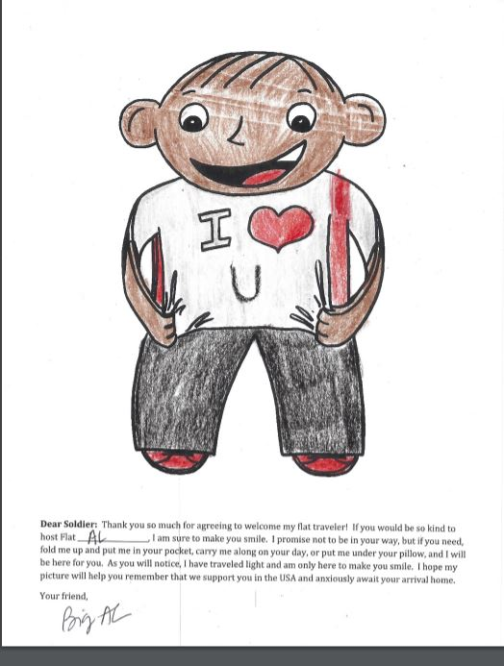
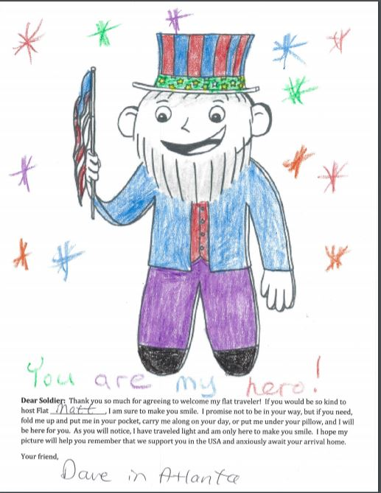
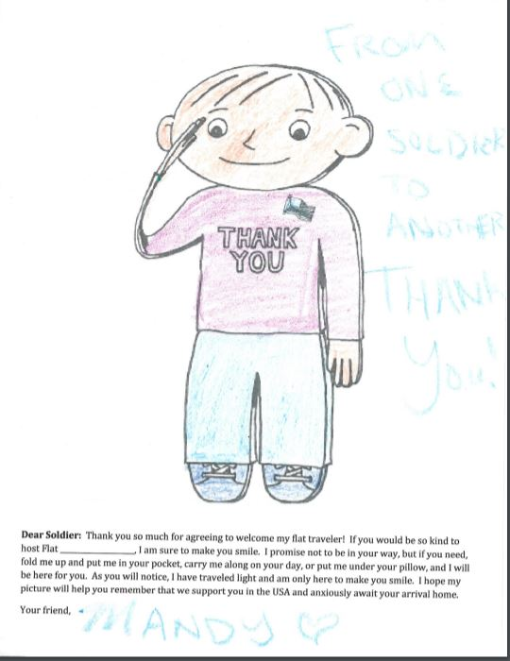
Flat Stanleys

Slide 24
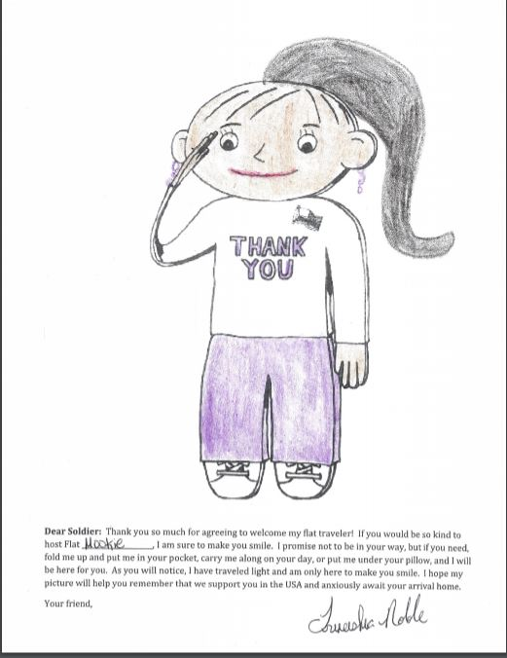
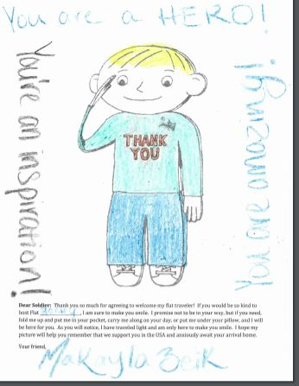
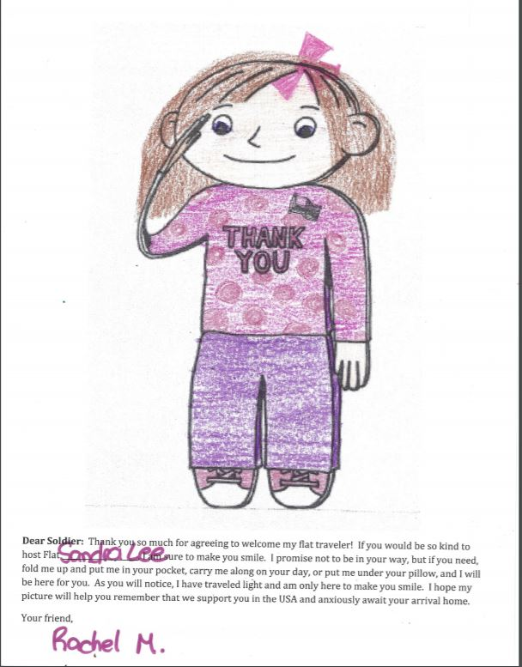
Flat Stanleys

Slide 25
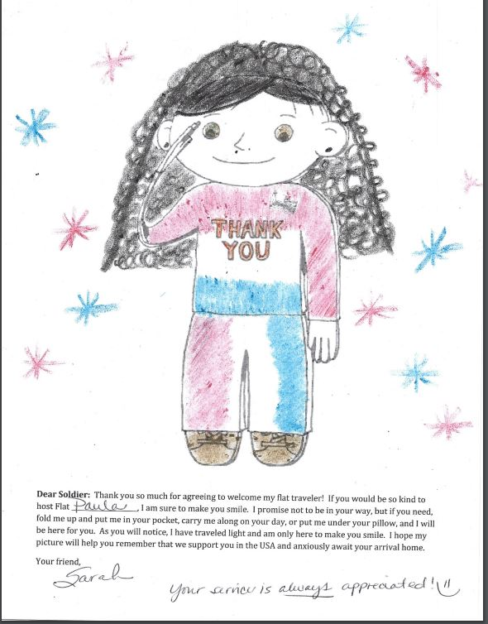
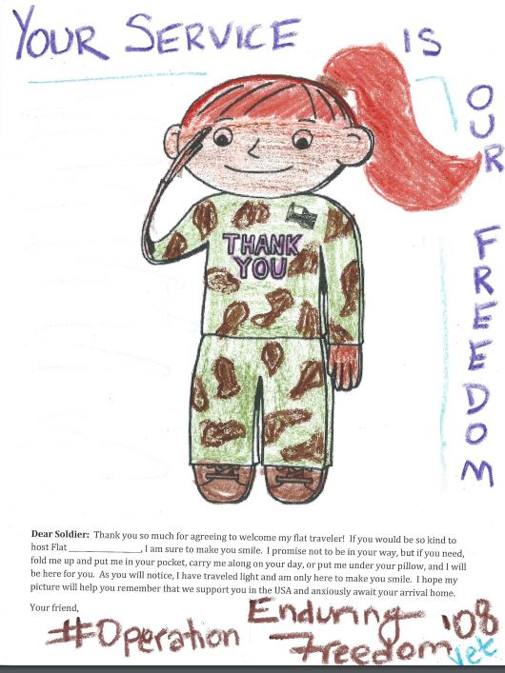
Flat Stanleys

Slide 26
Flat Stanley Template
Must only be used for support of military personnel, veterans, or first responders
Email: DaveKelly@GonzoSpeaks.com for the four templates

Slide 27
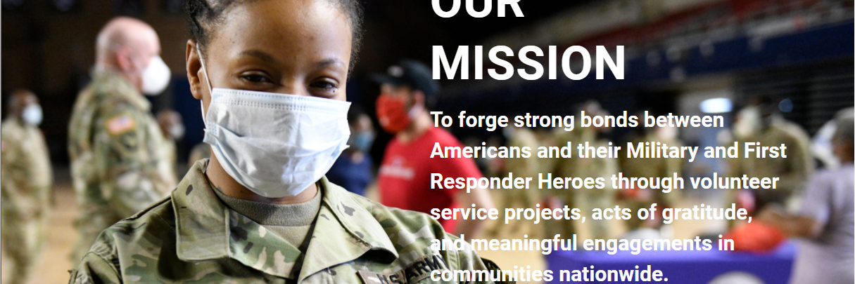
Operation Gratitude https://www.OperationGratitude.com/

Slide 28
Issues Affecting Retention
Watch for conflict and drama and approach it by using effective management modes.
This Photo by Unknown Author is licensed under CC BY-NC-ND

Slide 29

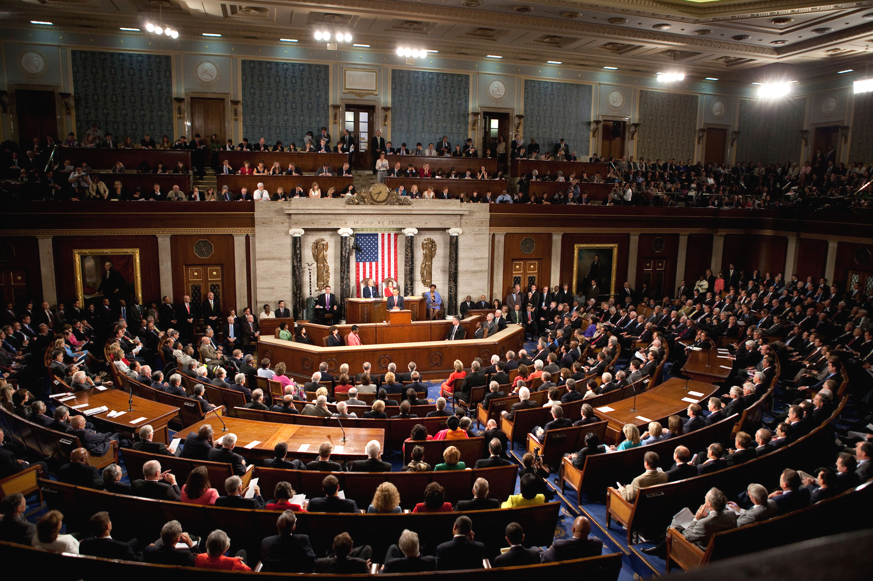
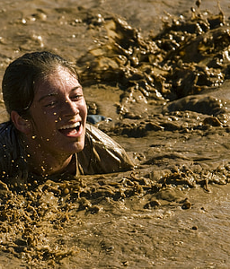

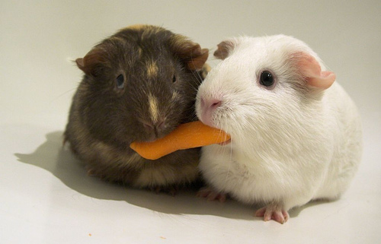
Modes of Managing Conflict
Compromise = Congress
Avoiding = Ostrich
Competing =
Survivor
Accommodating = Marriage
Collaborating =
Win-Win

Slide 30

Issues Affecting Retention
Challenges keep members from being involved.
This Photo by Unknown Author is licensed under CC BY

Slide 31

Issues Affecting Retention
Circumstances for the student have changed:
    Conflicts with work or class schedules.
    Another organization meets at the same time.
    Academic load may be heavier than expected.
This Photo by Unknown Author is licensed under CC BY-SA-NC

Slide 32

Issues Affecting Retention
  Employ:
    All available technology!
    Have more than one meeting per week, at a different time and day, perhaps led by the vice-president.
    Participation in projects and activities even if they cannot make meetings.
This Photo by Unknown Author is licensed under CC BY-SA-NC

Slide 33

Issues Affecting Retention
Financial issues.
  Consider the bare minimum that someone should have to pay to be involved.
  Use an installment plan for financial commitments.
  Conduct fund-raisers. (You must clearly state the purpose of the activity and what the money is for.)
    Virtual fundraising ideas: https://bit.ly/311YZyj
This Photo by Unknown Author is licensed under CC BY

Slide 34

Issues Affecting Retention
Members miss a lot of meetings.
  Call to let them know they were missed.
  Send a handwritten note (not an e-mail) that the member was missed and remind them of the next meeting.
  “Old school is the NEW school!”
This Photo by Unknown Author is licensed under CC BY-ND

Slide 35
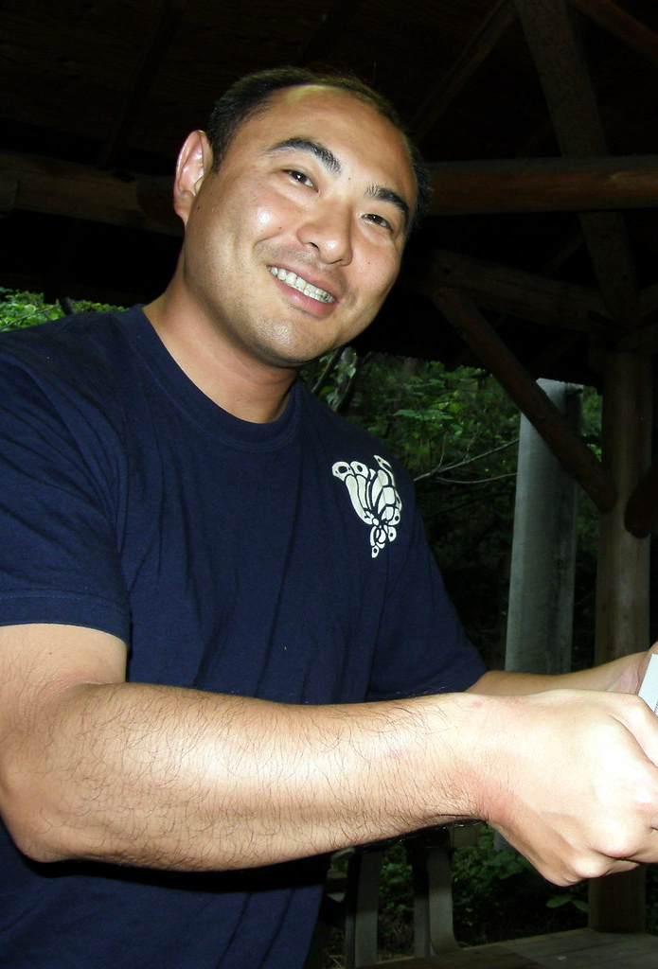
Issues Affecting Retention
Make the club or organization fun to to be a part of by making membership in the organization enjoyable.
  Conduct an induction ceremony.
  Give a certificate of membership or a name badge. Give value to membership in the group through benefits (scholarships, conventions, networking, etc.).
This Photo by Unknown Author is licensed under CC BY-SA-NC

Slide 36
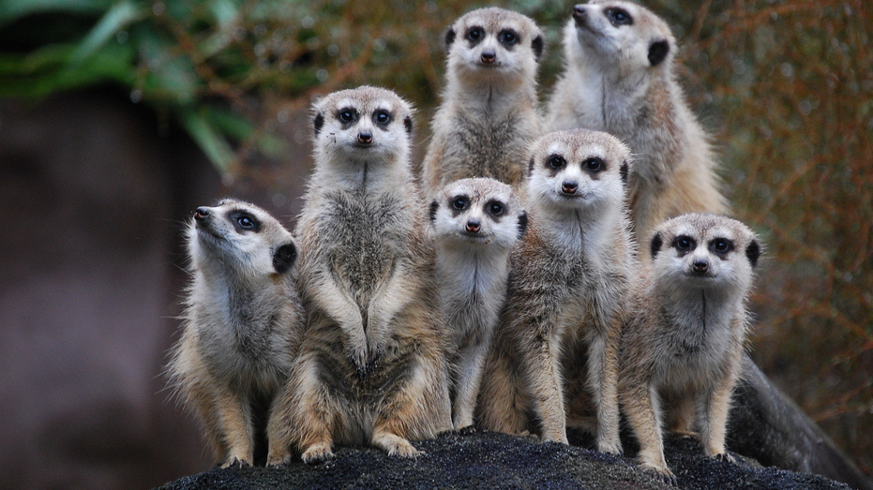
Breakout Rooms
This Photo by Unknown Author is licensed under CC BY-NC-ND

Slide 37

The Five (5) “R’s” of Retention
Give them a responsibility.
Enforce requirements.
Give out rewards.
Assign them a role-model.
Help build relationships.
This Photo by Unknown Author is licensed under CC BY-SA-NC

Slide 38
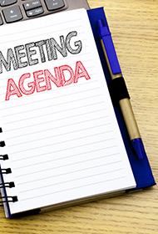
Points of Information
Play music.
Use ice-breakers and energizers.
Planned agenda.
Let people know in advance that they will be expected to speak or report.
This Photo by Unknown Author is licensed under CC BY

Slide 39
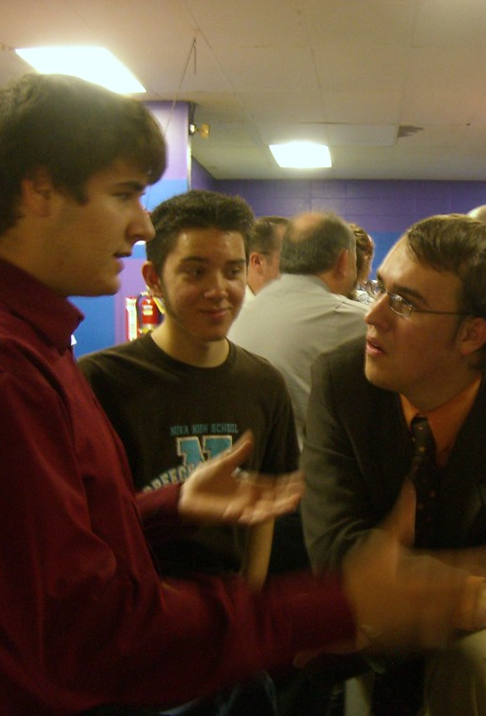
Points of Information
Rotate your meeting format:
  Week One: Business
  Week Two: Social
  Week Three: Service Project
  Week Four: Speaker
Start on time, end on time.
Use stories to make a point.
This Photo by Unknown Author is licensed under CC BY-SA

Slide 40

Q&A
This Photo by Unknown Author is licensed under CC BY

Slide 41

Thank you! www.DaveGonzoKelly.com
DaveKelly@GonzoSpeaks.com
770-552-6592
This Photo by Unknown Author is licensed under CC BY

