Slide 1
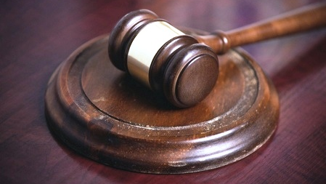
Parliamentary Procedure for
Student Government Members and Leaders
Dave Kelly
America’s Student Leadership Trainer^{sm}
This Photo by Unknown Author is licensed under CC BY-NC-ND

