Slide 2

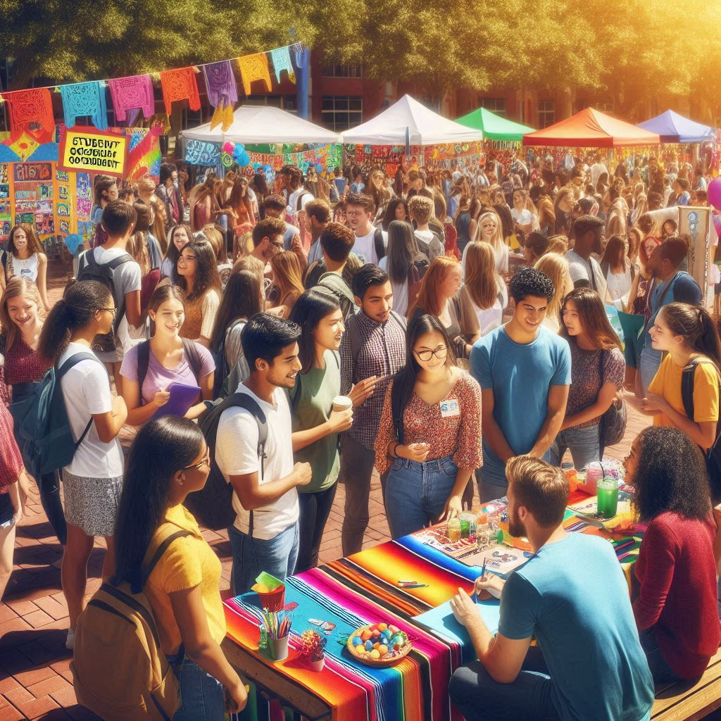
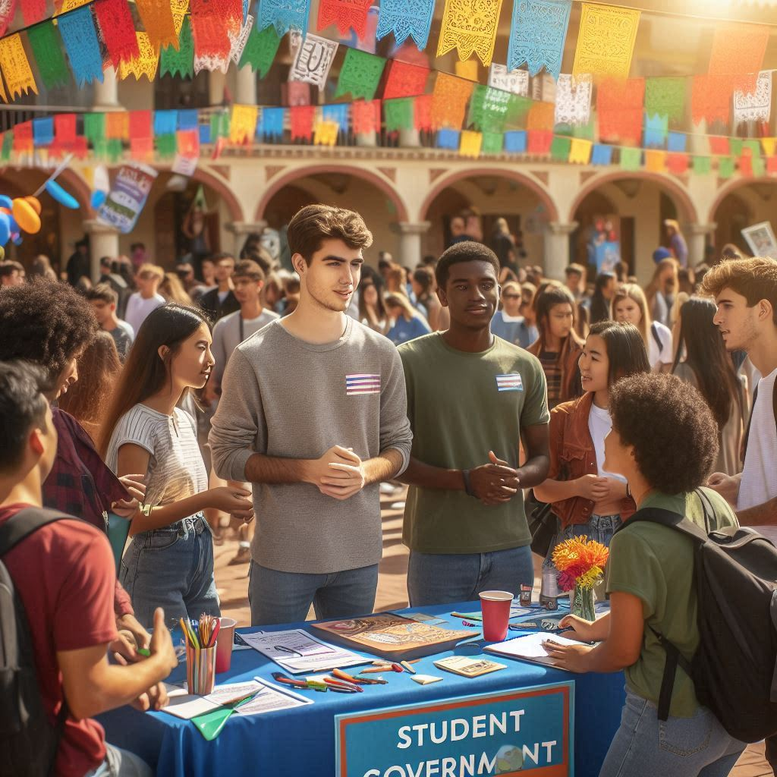
Notes:
This slide focuses on the recruitment process for student government. It covers strategies such as promoting awareness, hosting informational sessions, encouraging diversity, clarifying application procedures, and supporting candidates throughout the election process. Visuals represent student engagement and the application materials needed.

